Slide 1

INFRASTRUCTURE: societal impact, needs, funding & planning
Tony Horan
President, ACEI
Colloquium
CAPITAL INVESTMENT IN IRELAND
16th June 2017
Irish Congress of Trade Unions

Slide 2
WHAT IS INFRASTRUCTURE?
An important element of a modern society & economy
A determinant of health and an influencer of wellbeing
A ‘maker of places’
A provider of access, opportunity and equality
A mark of the value a nation puts on its society
Not an Extravagance
Needs to be conceived, planned, funded and delivered

Slide 3
INFRASTRUCTURE
Economic Infrastructure
Social Infrastructure
Common Feature & Benefits
Infrastructure goods are strongly used by public
Social cohesion and improved wellbeing in tandem with economic benefits

Slide 4
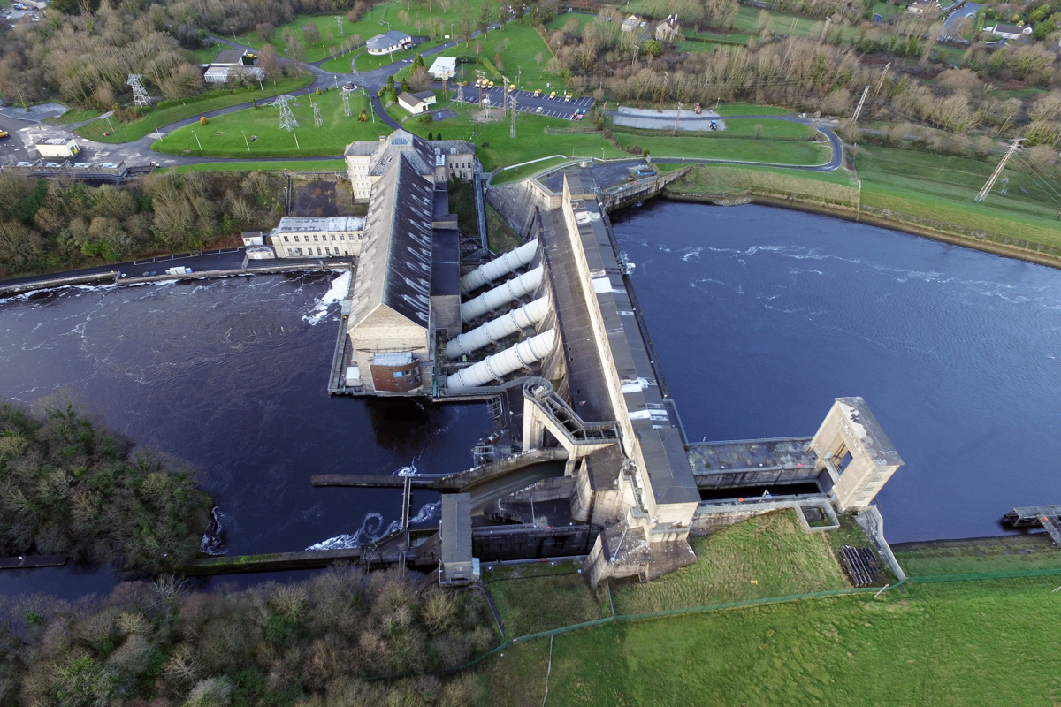

Slide 5
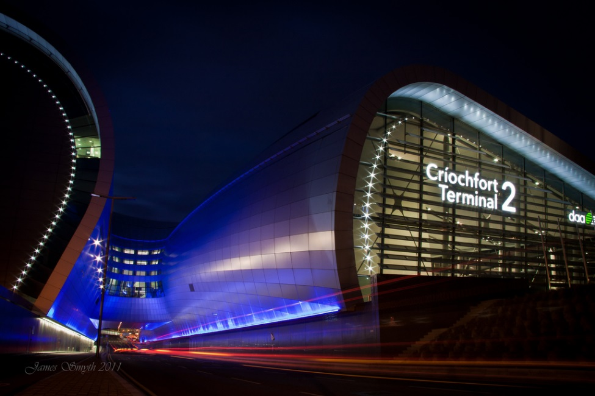
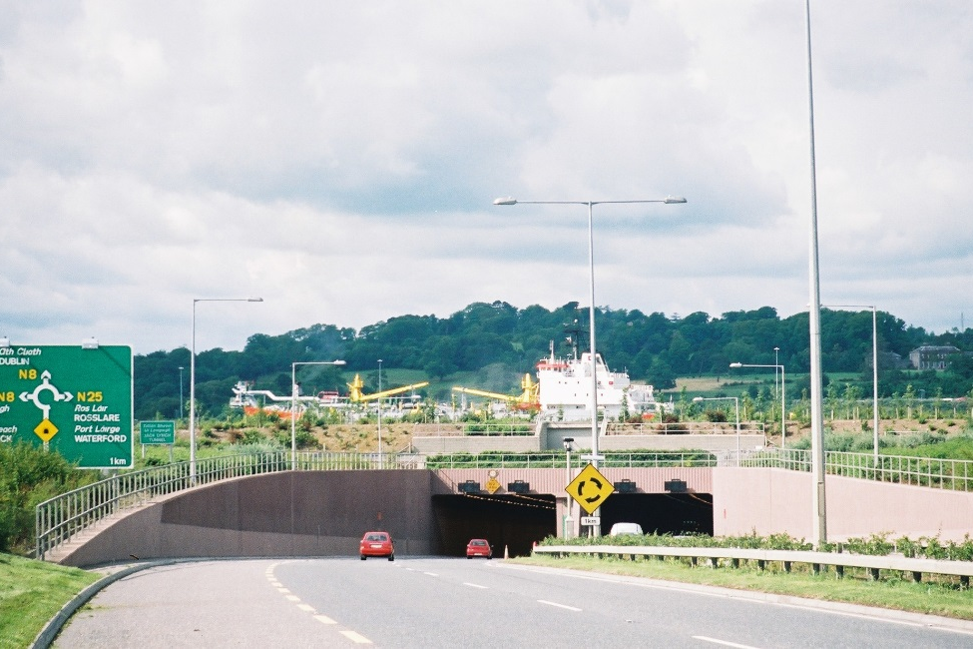
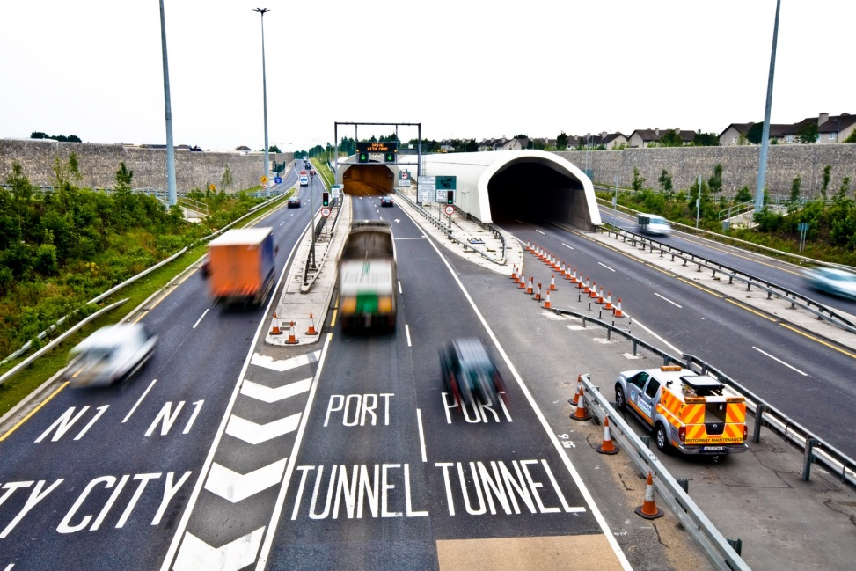


Slide 6
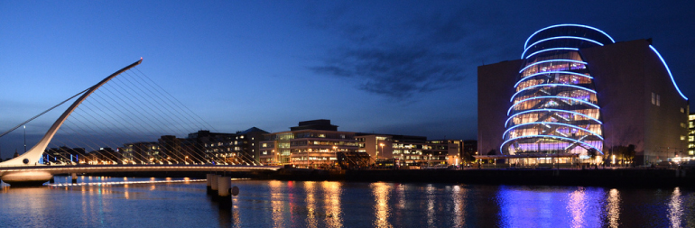
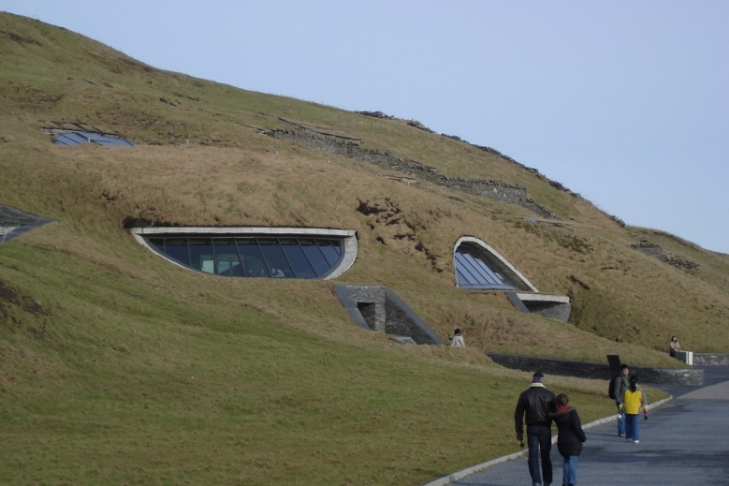
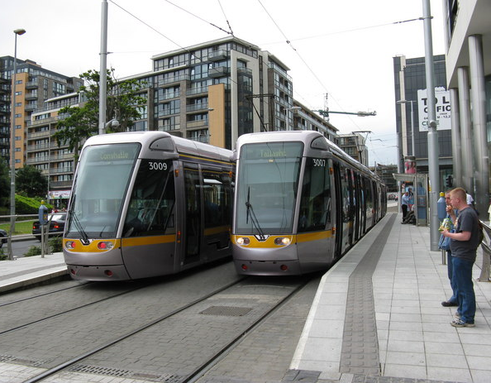
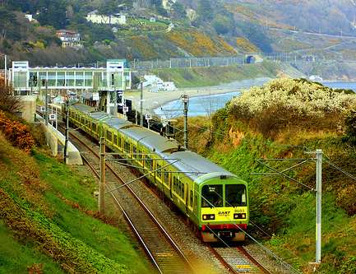

Slide 7

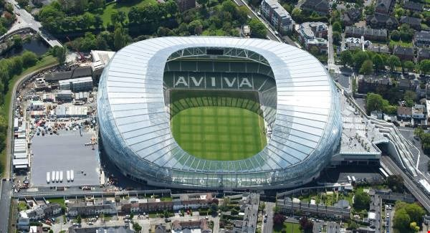

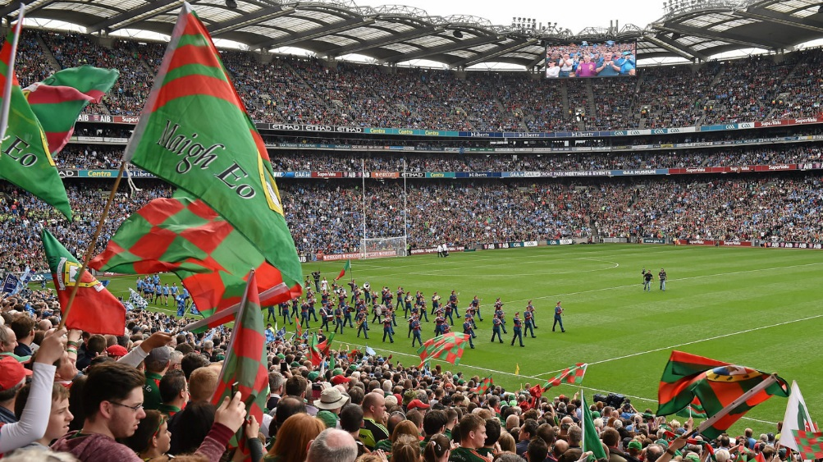


Slide 8
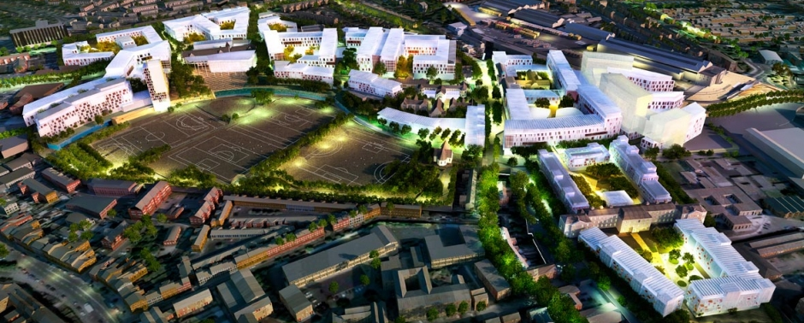
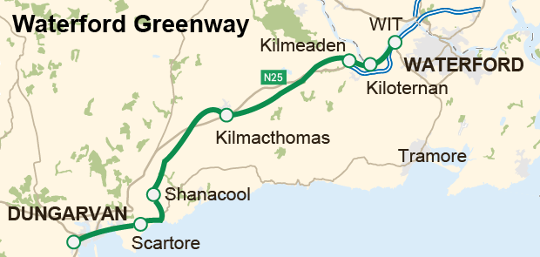
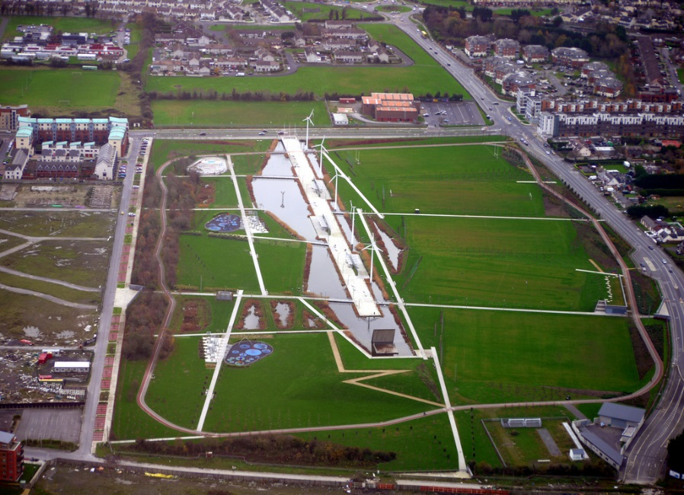

Slide 9
DRIVERS (CSO, Ireland 2040, DES)
Growing & Ageing Population
Participation levels in Education
Reducing household size
Changes in settlement patterns
Continuing adaptation to climate change

Slide 10
POPULATION 1961/2016 (CSO)

Slide 11
EDUCATION TRENDS: [DES 2015]

Slide 12
STATE OF IRELAND 2016 (EI)

Slide 13
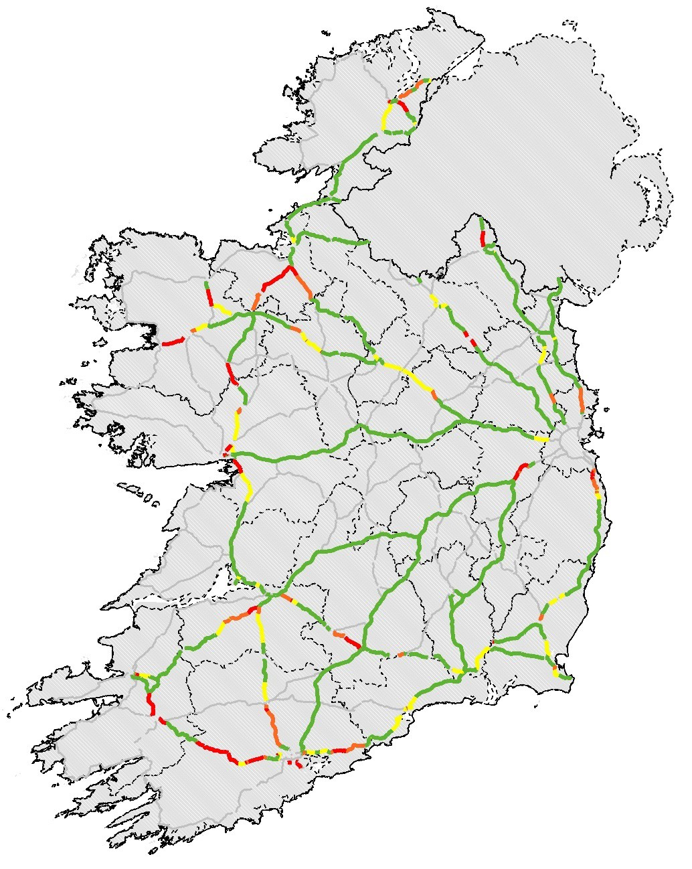
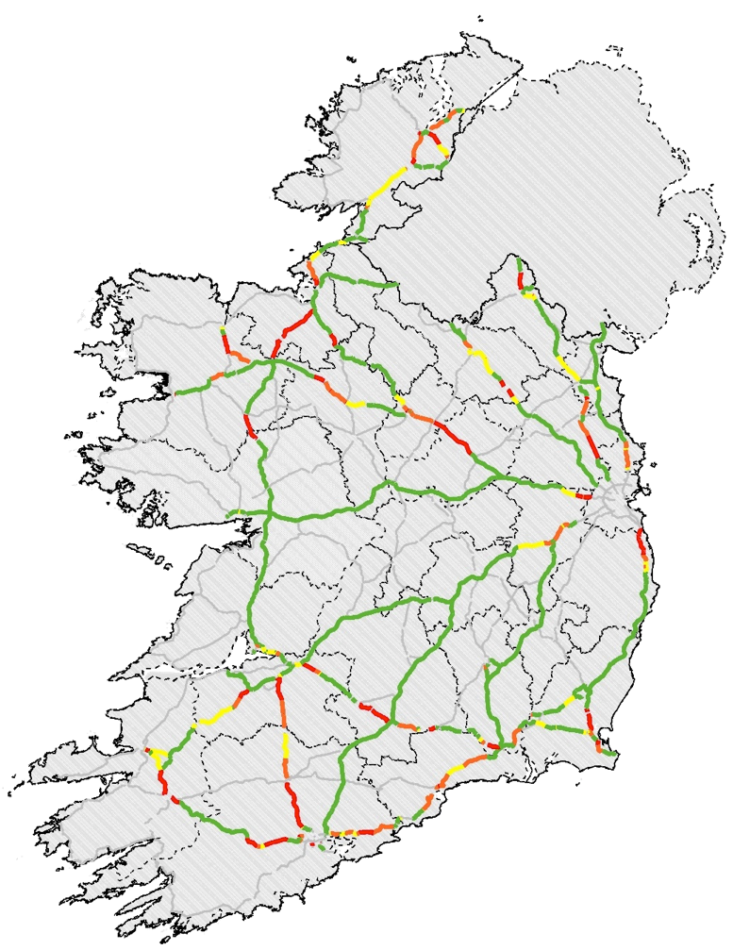
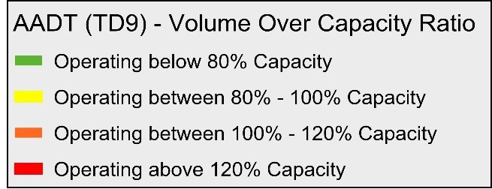
NATIONAL PRIMARY (TII)
2030
“Building on
Recovery”
2016

Slide 14
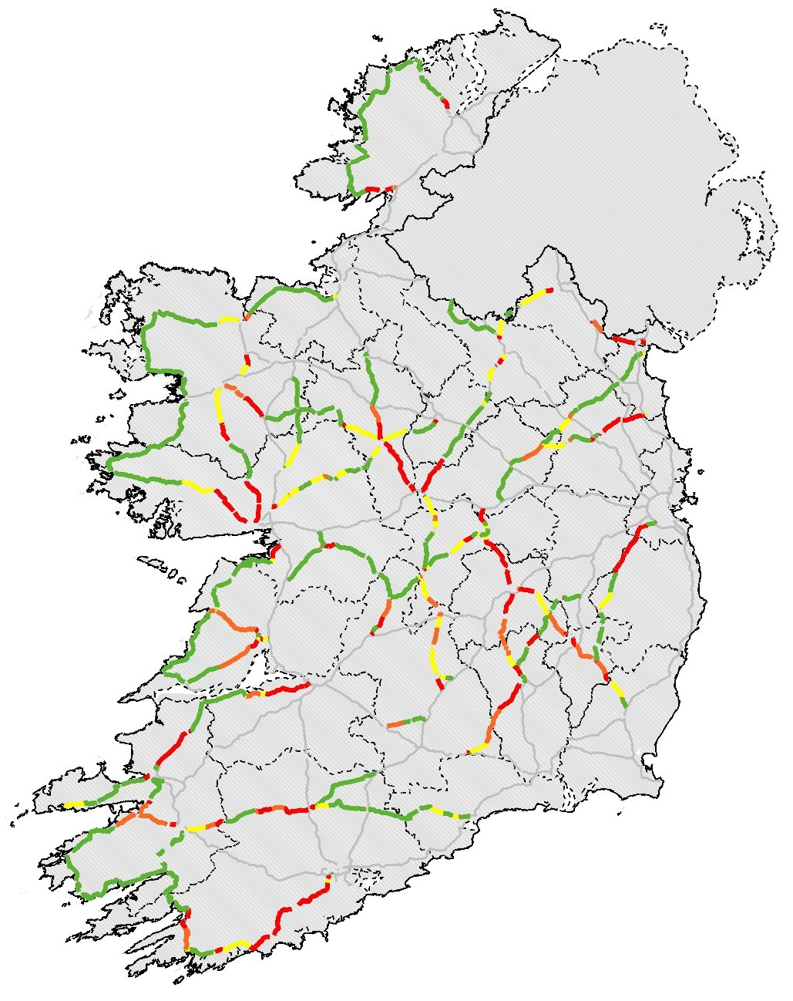
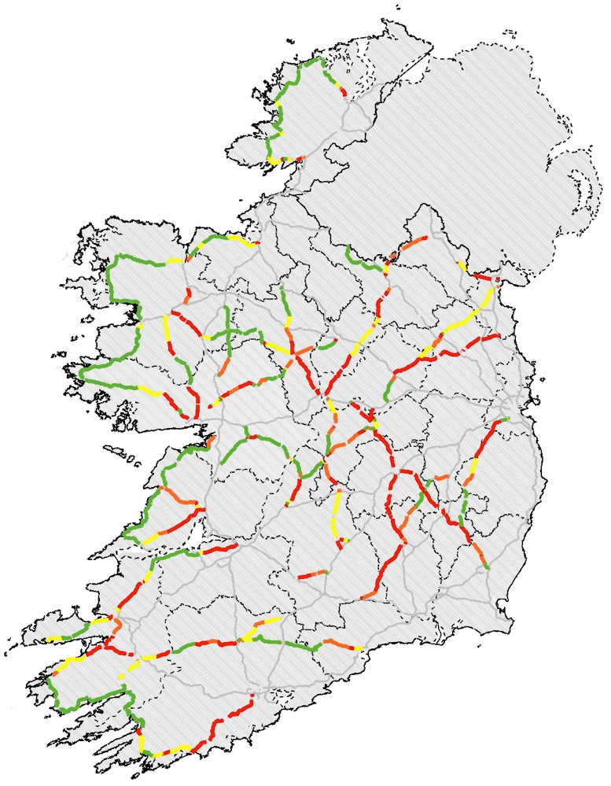
NATIONAL SECONDARY (TII)
2030
“Building on
Recovery”
2016
Source: National Transport Model

Slide 15

IW: INVESTMENT BREAKDOWN
Drinking Water Quality 17%
Capital Investment Plan to 2021
Drinking Water Quality | €950m
Drinking Water Capacity | €1,250m
Wastewater Quality | €1,250m
Wastewater Capacity | €700m
Infrastructure | €1,364m
Total | €5,514m
Infrastructure 25%
Waste Water Capacity 13%
Drinking Water Capacity
22%
Waste Water Quality
23%

Slide 16
INVESTMENT PROFILES
Investment curtailment 2010 – 2014
‘Building on Recovery’ 2016 – 2021 €42 billion + €5.1billion
Accumulated funding gap large and growing
Increased investment and Long term Planning needed

Slide 17
FUNDING ISSUES
Small, open economy cyclical trends
Long term inadequate/uncertain funding
Uncertainty impacts on resource availability, skills retention and capacity
Long term vision vital
Planning horizons 30 – 50 years required
Political and public consensus required

Slide 18
NATIONAL COMPETITIVENESS
Investment significant challenge in light of demographic pressure, EU budgetary commitments and deficits in telecommunications, innovation, transport and water
Proportion of gross fixed capital formation (2%) below UK and Euro average (2.7%)
Quality of infrastructure 38th, lower than UK (24th) and US (11th) (WEF)
‘Benchmarking Competitiveness: Ireland and the United Kingdom, 2017’

Slide 19
IRISH ACADEMY OF ENGINEERING
The shortfall in investment in infrastructure and the perceptions of the quality of our infrastructure, allied with the ongoing needs of a growing population and economy, means that long term planning strategies must cater for significantly increased investment in infrastructure Spatial Planning on the Island of Ireland (April, 2016)

Slide 20
ONE STOP INFRASTRUCTURE SHOP
National Infrastructure Council
Evidence based Priority List
Funding models Public, Private, PPP, Equity

Slide 21
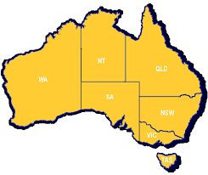
INFRASTRUCTURE AUSTRALIA
Why we developed the Infrastructure Priority List
“Defining Australia’s infrastructure priorities is important for governments, investors, industry and the community. It guides government decision making on how best to allocate resources, provides transparency on future spending priorities, and supports economic growth. It also provides industry with a clear forward program of works, which helps ensure that Australia retains specialist skills to deliver the infrastructure we need”

Slide 22
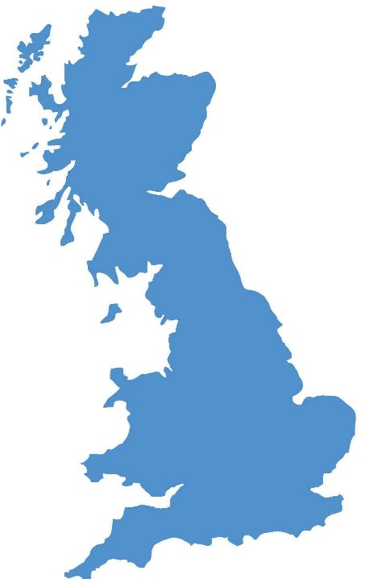
UK NATIONAL INFRASTRUCTURE COMMISSION
National Infrastructural Commission
20 to 30 year horizon
Input to national prioritisation
National Infrastructure Assessment
15 week ‘Call for Evidence’

Slide 23
PIPELINE PLANNING (TII)
National Development Plan 2000-2006
National Development Plan 2007-2013
Building on Recovery: Infrastructure & Capital Investment 2016-2021
2,500
2,000
1,500
1,000
500
0
2000
2005
2010
2015 2020
Lane-km With Planning Approval -Not at Construction
2025
Lane-km Under Construction

Slide 24
CONCLUSIONS
Infrastructure’s Social & Economic roles
Existing & Projected Deficiencies
Demographic & Economic drivers
Long Term Planning & Investment needed
National Infrastructure Council
Evidenced-based Priority List
Appropriate Funding Models
Industry Certainty

