Slide 1
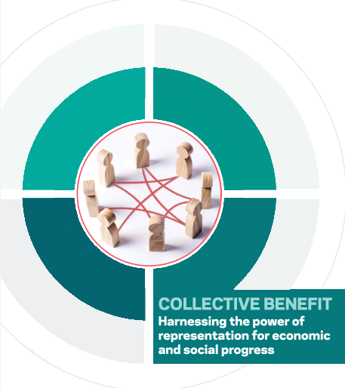
Alan Eustace May 2021

Slide 2
Collective bargaining
ILO: Negotiations between workers’ organisations and employers or their organisations to reach agreement on terms & conditions of employment or the relationship between management and workers
Benefits for higher wages, equality, productivity, innovation and competition
Ease of doing business
Fundamental human right, protected by international and European law
International and domestic political momentum

Slide 3
Ireland v Europe
 | Ireland | EU | EU14
Collective bargaining coverage | 33.5% (18% private sector) | 60% | 73% (Ireland 2nd-lowest)
Trade union density | 24.4% | 26.5% | 33%
Industrial Relations Index | 56.09 (10th in EU) | 53.3 | 60.83
Industrial democracy | 46.05 (15th in EU) | 61.81 | 62.73 (Ireland 3rd-lowest)
Associational governance | 36.83 | 42.06 | 58.28
Representation and participation | 44.44 | 63.69 | 76.98 (Ireland joint-lowest)

Slide 4
Why?
Effects of the Financial Crisis
Constitutional court decisions
Voluntarist tradition

Slide 5
Comparative analysis

Slide 6
1. Importance of sectoral bargaining and extension of agreements
Sectoral bargaining is key to high coverage rates and quality of bargaining process
Incentives for employers to bargain at sectoral level
Extension of agreements
Public procurement

Slide 7
2. Incentivising trade union membership
Avoid free-rider problem
Tax deductions
Reserved benefits
Ghent system
Paid time off and protection against detriment

Slide 8
3. Collective bargaining secures industrial peace, economic stability and flexibility
Industrial peace
Flexible regulation, tailored to economic realities
Productivity and innovation
Culture shift

Slide 9
4. Importance of union presence and worker representation in the enterprise
Works councils
Company boards of directors
Relationships with trade unions

Slide 10
EU law
Fundamental rights and Union policy
Internal market and competition law
Participation directives
Proposed directive on adequate minimum wages (AMWD)

Slide 11
Questions?
Thank you
Alan Eustace May 2021

