Slide 1
Congress Friday briefing 21st JULY, 2017
JIMMY O’CONNOR & PASCAL CONNOLLY
Communications Workers’ Union

Slide 2
WHAT IS CWUHA?
Communications Workers’ Union Humanitarian Aid (“CWUHA”)
CWUHA is a project developed to respond to the plight of vulnerable children in Eastern European countries, by trade unionists in Ireland and the UK from the postal and telecoms industries

Slide 3
HOW AND WHY DID IT ALL BEGIN?
End of the Bosnian war in 1995
The war lasted from 1992-1995
There were an estimated 100,000 people killed
Bosnia’s orphans were failed by a dysfunctional state, which seemed unconcerned with its most vulnerable citizens
Authorities did not inspect irregularities in institutions, where many children lived
These children’s backgrounds were marked by extreme poverty and upheaval
CWUHA was set up in response to a call from trade unionists living in war-torn Bosnia, particularly those in the town of Tuzla

Slide 4
HOW AND WHY DID IT ALL BEGIN? (contd)
The first CWUHA convoy arrived in Tuzla in July 1995
There was a determination to deliver aid directly to those who needed it most
Constant danger that aid would fall into the hands of self-interested middlemen
Many of the children residing in orphanages were not orphans, but were placed there by families who, confronted with overwhelming financial problems, believed that their children would be better cared for in these institutions

Slide 5
First CWUHA CONVOY: 1995
The determination to deliver vital aid directly to those in need, cutting out any intermediaries, set the agenda for every CWUHA convoy that was to follow
CWUHA guarantee to every donor that ALL aid goes directly to the children in need

Slide 6
CWUHA: 1996-1999
In 1996 money was raised to send a further two convoys with humanitarian aid to Bosnia
By the end of 1996 the situation in Bosnia had improved and CWUHA, acting on professional advice, decided to direct its efforts to providing assistance to orphanages in Bulgaria
This was the beginning of a very successful three-year period (1997-1999), during which, with the help of the Bulgarian government and people, CWUHA was able to deliver many tonnes of vital aid to disadvantaged children
Also during 1999, an emergency convoy was sent to Albania to help the people of Kosovo, who became refugees as a result of the conflict in their homeland

Slide 7
CHARITABLE STATUS
CWUHA applied for, and was granted, charitable status; this was a proud moment and a unique situation within the trade union movement

Slide 8
CWUHA – NOT JUST CONVOYS
In addition to humanitarian aid convoys, CWUHA has funded renovations in:
School in Moshi, Tanzania, for 50 children
Social assistance and foster & adoption centres
A playground at a hospital for children with disabilities
A centre for street children in Moldova

Slide 9
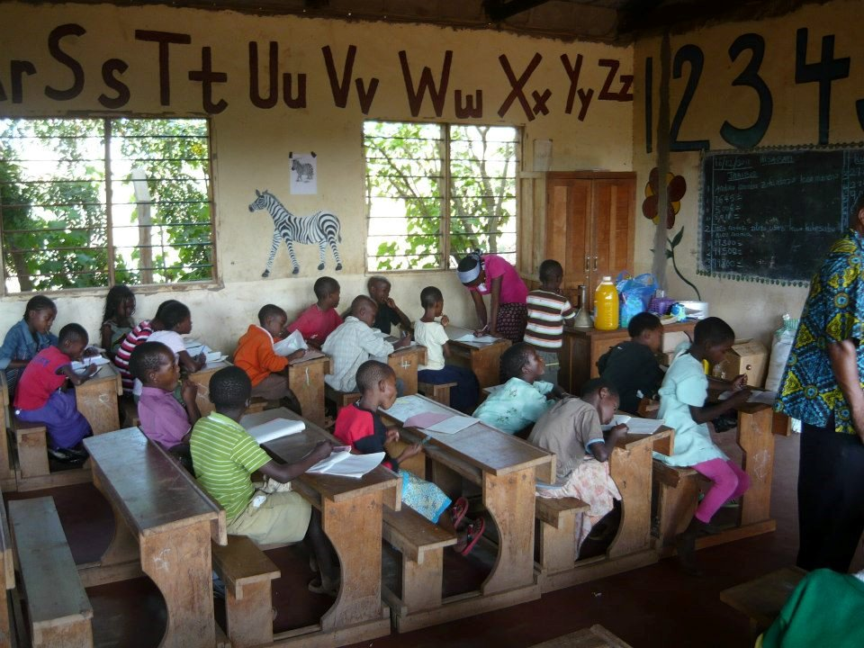
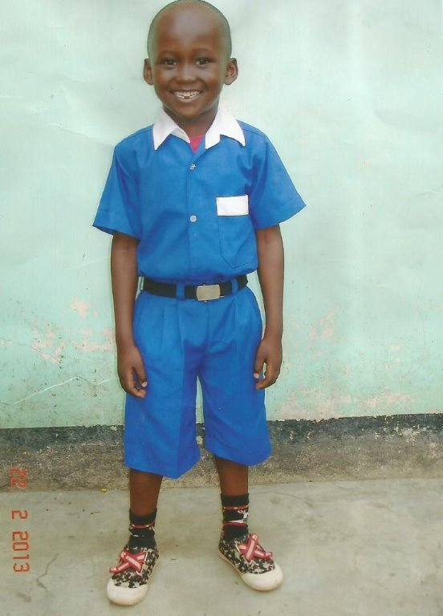
Tanzania - school

Slide 10
CWUHA: 2000-2012
Between the year 2000 and 2012, multiple convoys took place to a number of Eastern European countries, including:
Moldova and Ukraine in 2006
Lithuania and Moldova (Transnistra) in 2007
Bulgaria in 2009, 2011, 2013 and 2014
Lithuania again in 2012

Slide 11
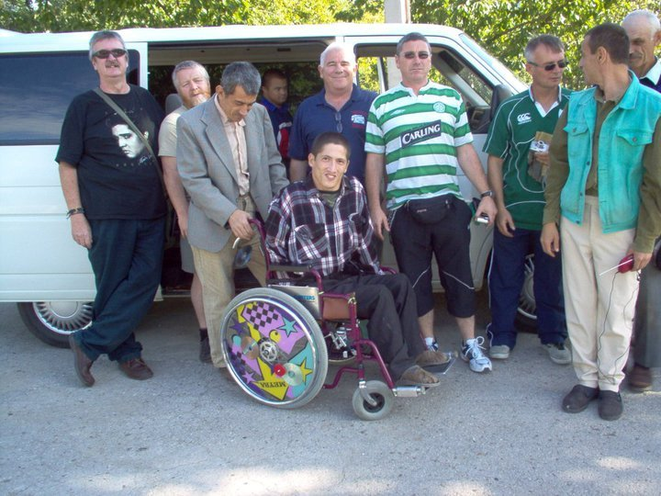
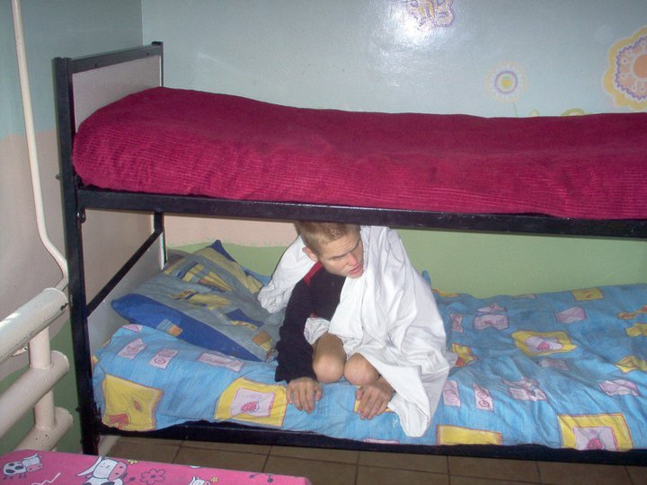
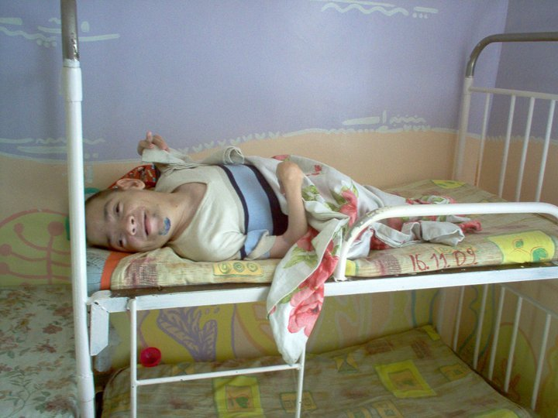
Transnistra

Slide 12
CWUHA 20TH ANNIVERSARY-Moldova, 2015
The convoy in 2015 was extremely special as it marked the 20th anniversary of the foundation of CWUHA
It also coincided with the opening of the Phoenix Centre in Riscan
This centre is the first of its kind in Moldova, catering for children with physical disabilities, who would otherwise not receive any education or therapy

Slide 13
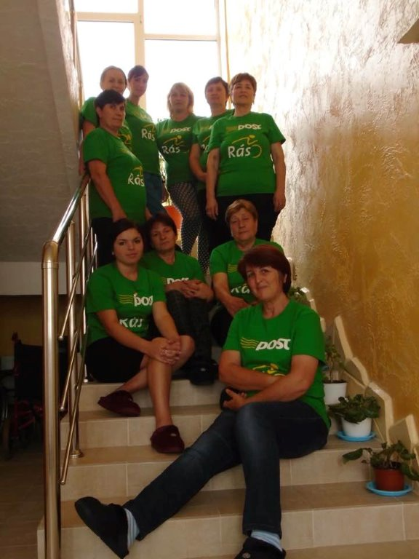
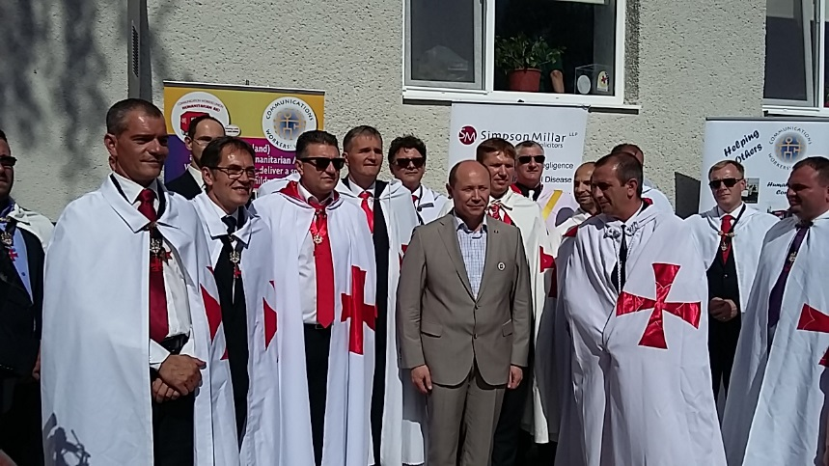
Moldova – phoenix centre

Slide 14
2015: THE JOURNEY
9th September 2015 – After months of fundraising, packing, loading, and labelling, all three Irish vehicles set off to meet our UK counterparts in Hull
Then from Hull the trucks made their way to Zeebrugge and on to the motorway for Germany
Three long days of driving, passing refugee camps on the Hungarian border and seeing the deplorable conditions these people were living in first-hand was, to say the least, shocking

Slide 15
2015 Convoy group

Slide 16
ROADS, BORDER CROSSINGS & PAPERWORK
Five more long days, in the company of other crazy drivers on the road (not our own!), and then the border crossing at Sculeni was in sight
Crossing from the Romanian side was fairly quick, but the Moldovan border guards were a different kettle of fish!
We were left stranded in ‘no man’s land’ while the paperwork was sorted out

Slide 17
ARRIVAL AT THE Phoenix CENTRE
The problem was eventually resolved and we set off once again
However, we were now on Moldovan roads and the less said about that, the better!
Via Balti, we headed for the Phoenix Centre
One complete wing of the building had been transformed from a crumbling wreck, to a state-of-the-art facility
All that was needed now were the fixtures & fittings, and these were in the convoy’s trucks

Slide 18
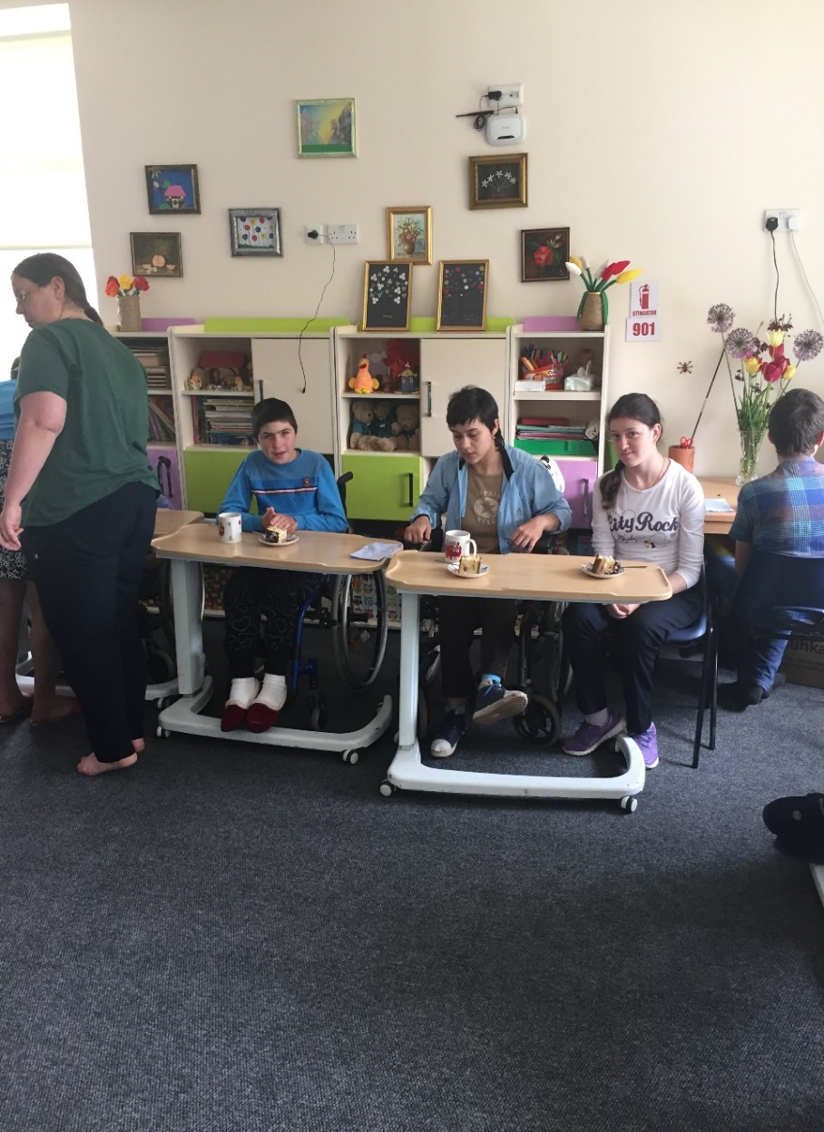
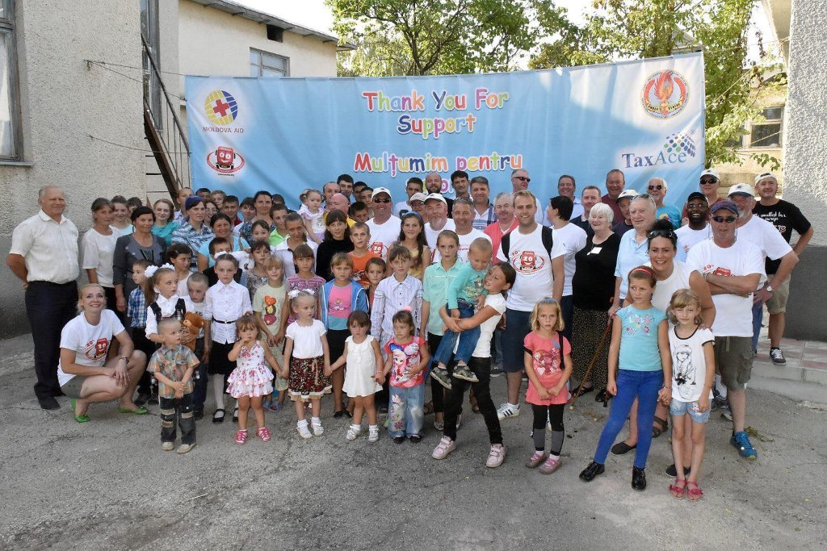
Phoenix Centre - Welcome party

Slide 19
GRATITUDE AND APPRECIATION
When the aid was unloaded, we were greeted with cheers and gasps of appreciation
Tears were shed when they saw what we had brought
Some aid was for local families in need, and some for local hospitals and an orphanage
There were hugs and handshakes all round ☺

Slide 20
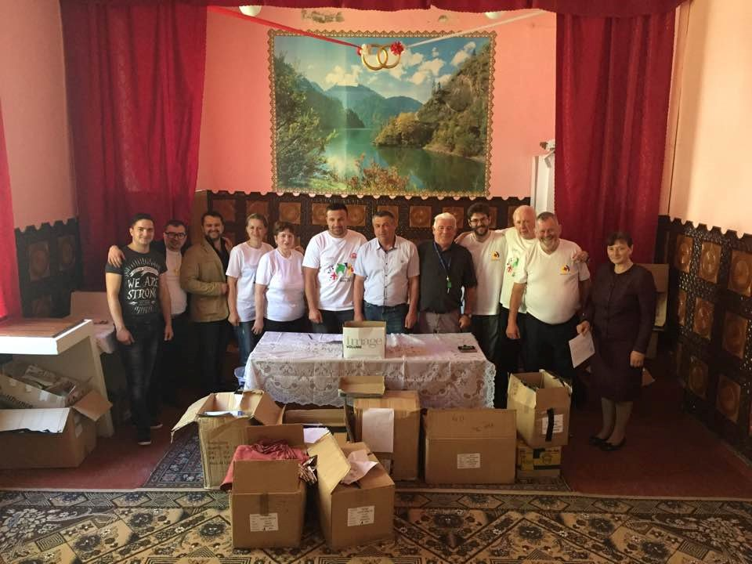
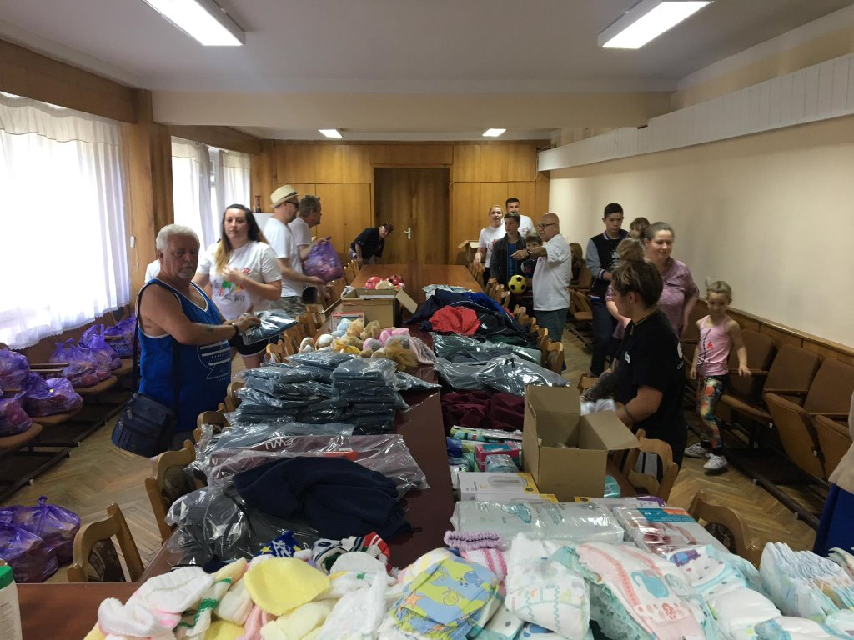
Aid for the vulnerable families

Slide 21
HOW THE OTHER HALF LIVES
At this point, the convoy split into two groups – one for the hospital in Riscan and the other going to the orphanage a few kilometres away
We witnessed the most extreme divide in wealth – there were ornate mansions surrounded by families living in homes that looked like pigeon lofts

Slide 22
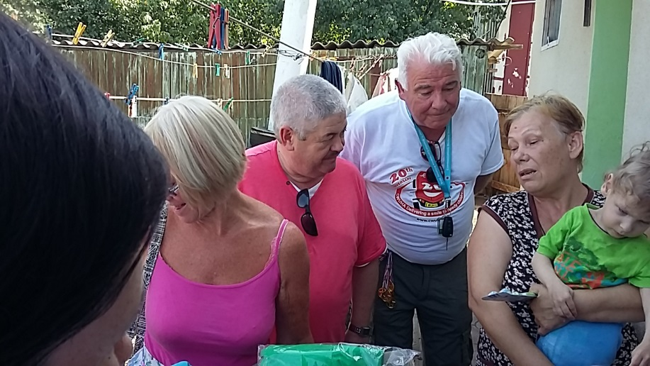
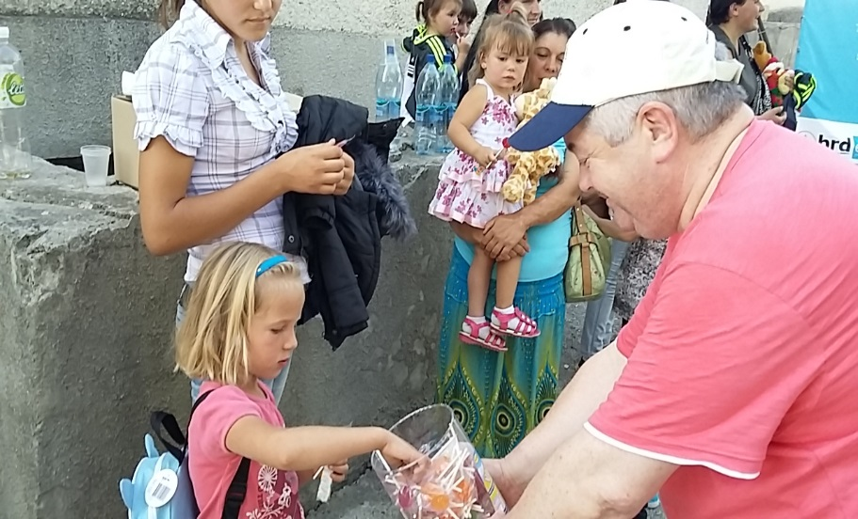
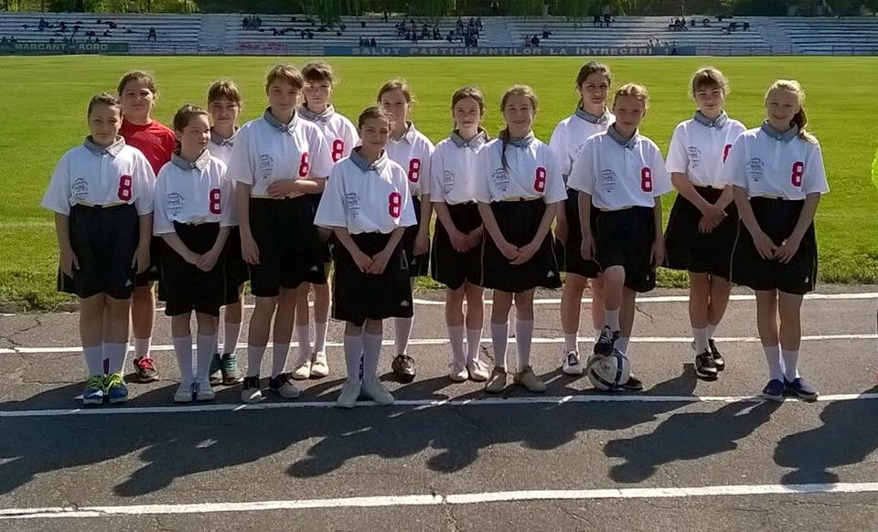
Moldova 2015

Slide 23
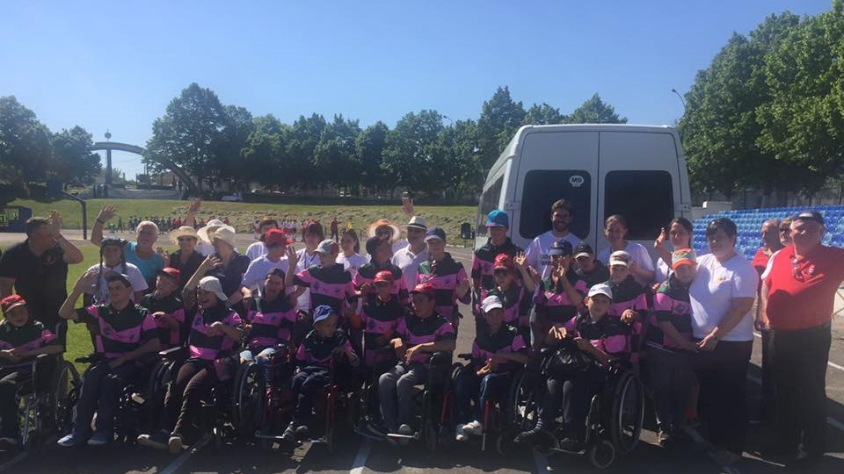
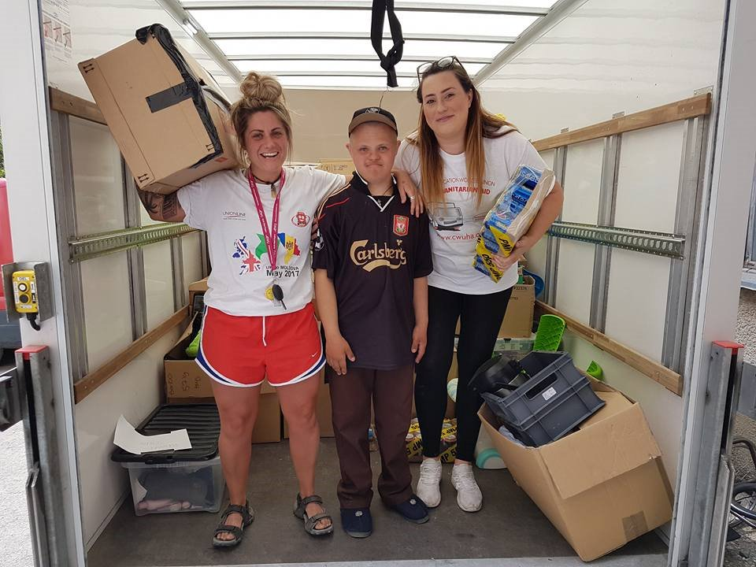
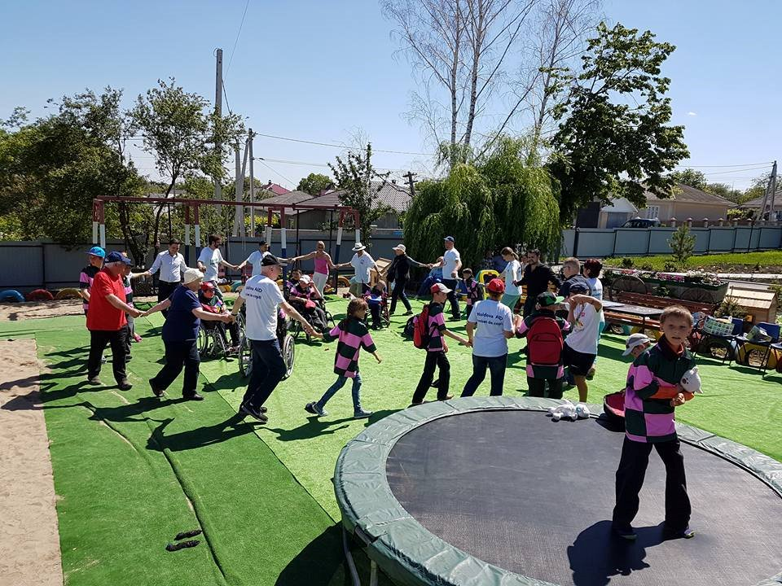
Moldova 2015

Slide 24
Delivering a special wish
On the 18th December 2012, TV3 broadcast a documentary ‘Delivering a Special Wish’, which followed the CWUHA convoy on its journey to Lithuania
CWU feel that the trade union movement do not get any credit from mainstream media for the good deeds done by its members

Slide 25
Next project
Orphanage outside Chisinau, Moldova
500 children
Old military building
Refurbish the orphanage in phases
Address immediate need for beds, clothes, medical equipment, and food

Slide 26
The future of cwuha
CWUHA would have no objection to other unions getting involved in this project
Currently the project aims to deliver two convoys annually – in May and September

Slide 27
5 star accommodation

Slide 28
Thank you for your attention

