Slide 1
Regional Transition Team Midlands Regional Enterprise Plan to 2020
Anna Marie Delaney, Chief Executive, Offaly County Council
April 30th 2019

Slide 2
Bord na Mona & the Midlands…… its part of our DNA
Bord na Mona has harvested peatlands in the region since 1930’s
At the core of many families and communities
Accounts for approx. 2000 direct jobs and supports a further 2000 indirectly

Slide 3
21 Bog Areas will cease operations in 2019
Boora/Blackwater | County | Derrygreenagh | County | Mountdillon | County | Horticulture Bogs | County
Bellair | Offaly/Westmeath | Derrylea | Offaly/Laoise | Mountdillon | Roscommon | Umeras | Kildare
Kilgarvin/Bunahinley | Westmeath | Toar | Offaly/Westmeath | Edera | Longford
Drumlosh | Roscommon | Daingean | Offaly | Coolnagun | Westmeath
Derryfadda | Galway/Roscommon | Derryhinch | Westmeath | Milkernagh | Westmeath
Kiladerry | Galway/Roscommon | Ballydermot | Offaly
Castlegar | Galway/Roscommon | Blackriver | Kildare
Gowla | Galway/Roscommon | Drumman | Offaly/Westmeath
Boughill | Galway/Roscommon | Lemonaghan | Offaly

Slide 4
Employees leaving in 2019
387 will leave before end of 2019

Slide 5
Objectives of Regional Transition Team
To pursue funding opportunities and actions to mitigate the impact of the BnM job losses on the individuals concerned, and the impact on the Local and Regional Economy
Position the Region to develop alternative forms of employment, attract investment and maximise existing employment opportunities and resources

Slide 6
Membership of Transition Team
Bord na Mona, Members of the Council and executive,
LAs: Laois, Longford, Offaly, Westmeath, Roscommon & Kildare
Local Dáil Deputies,
The Chair & Secretariat of the Midlands Regional Enterprise Plan to 2020,
Regional and local representatives from IDA Ireland, Enterprise Ireland, LEOs,
Department of Employment Affairs and Social Protection,
Regional Skills Forum, ETB’s, AIT,
Chambers of Commerce,
Climate Action Regional Office (CARO)

Slide 7
Programme of Work to deliver on objectives of the Regional Transition Team
4 Working Groups
WG1 - Securing special status / designation for Offaly and the Midland
Region & Funding Opportunities
WG2 - Addressing the needs of those offered redundancy & Emerging
Employment Opportunities
WG3 - Emerging Property/Land Opportunities
WG4 – Marketing Offaly & the Region

Slide 8
WG1 - Securing special status / designation for Offaly and the Midland Region & Funding Opportunities
Ministerial Meeting
Just Transition Platform
Progressed by Bord na Mona in close co-operation with Department of Climate Action in terms of Supported by the Regional Transition Team
Country Team
European Globalisation Fund
Dept of Education & Skills in discussion with EU regarding eligibility for fund
Climate Action Fund – under consideration by BnM

Slide 9
Informing Policy….. Midlands Regional Enterprise Plan to 2020
Objective 1: Ensuring the Midlands is well positioned to address the challenges posed by climate change as it moves towards renewable energy
Action 1: Support the actions of the Regional Transition Team
Action 2: Support the development & designation of Portlaoise
as low carbon town
Action 3: Develop and implement County Climate Adaptation
Strategies
Actions 4-6: Feasibilities relating to development of Energy Park,
aquaculture trials, herb trials

Slide 10
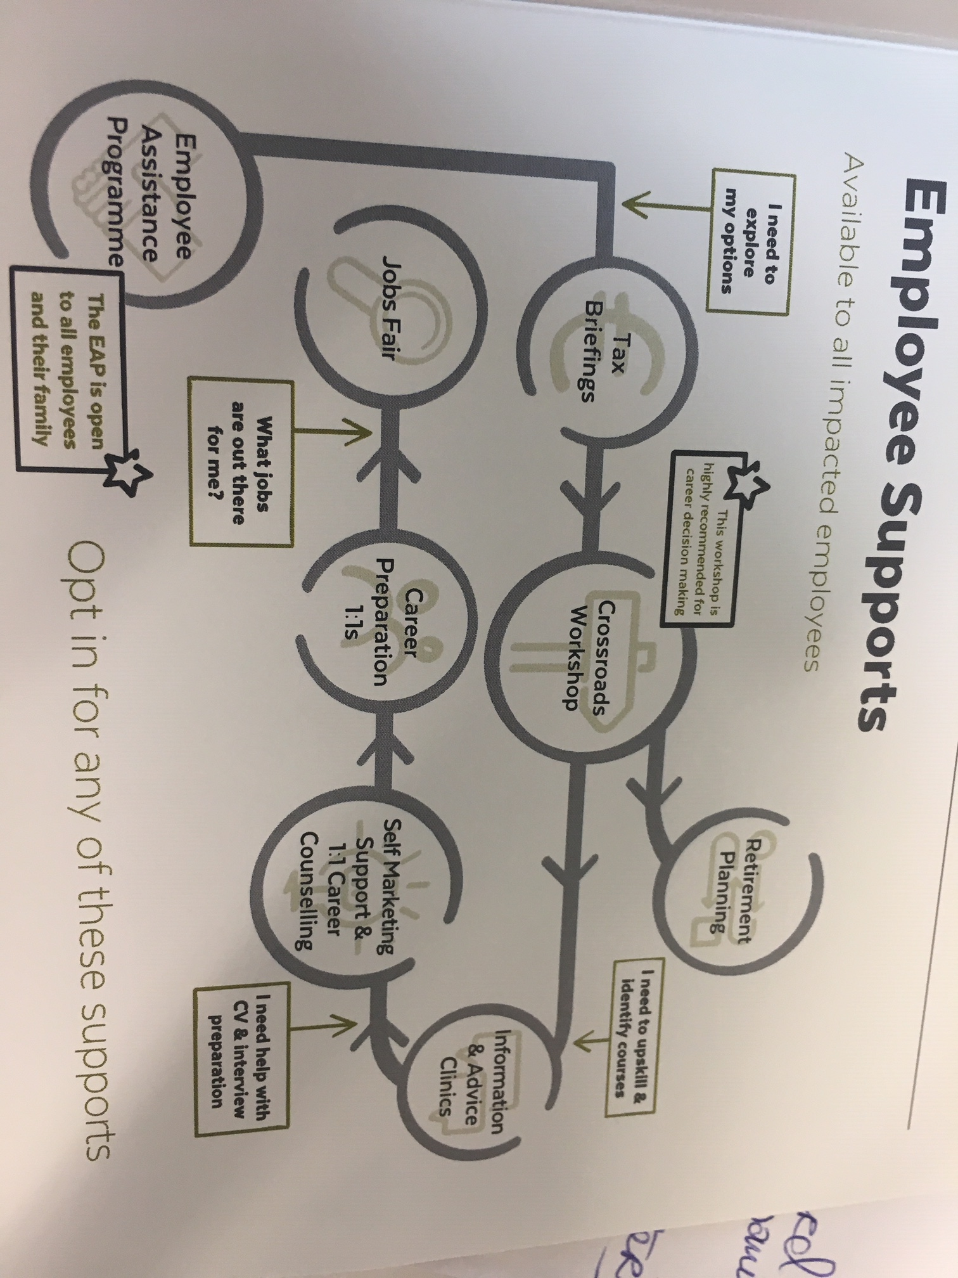
WG2 - Addressing the needs of those offered redundancy & Emerging Employment Opportunities
Numerous clinics held in bog Communities facilitated by members of the Regional Transition Team, including Department of Employment Affairs and Social Protection, Regional Skills Forum, ETB’s & AIT
AIT & Regional Skills Forum submitted 9 Springboard + applications for skills to advance programmes for those leaving BnM through VR – including Advanced manufacturing and Pharma courses
ETBs and Local Development Companies developing bespoke courses for Skills to Advance for those accepting VR

Slide 11
WG3 - Emerging Property/Land Opportunities
Bord na Mona set to Expand the Core and Scale the New
……. in line with proper and sustainable planning and development
BnM undertaking a number of technical trials in sites across the Midlands to develop new business e.g birchwater, aquaculture and herbs
BnM also in process of identifying sites for expanding their renewable energy projects and to develop Energy Parks e.g solar, wind farms etc
Feasibilities:
to develop Lough Boora Discovery Park into an Eco Tourism destination of national and international significance
to identify sites that are suitable for data centre development and complete a feasibility study and planning designations

Slide 12
Big Idea Generation Bootcamp & Employment Opportunities in the Midlands: Skills, Education & Jobs Fair
Friday, May 17th, 2019, Mount Lucas Training Centre
Idea Generation Bootcamp
Skills, Education & Jobs Fair
Target casual, seasonal and those FT BnM Employees exiting under VR
Sectoral focus – manufacturing and construction
Working with BnM, CIF, IDA Ireland, Enterprise Ireland, LEOs, Regional Skills Forum, ETBs
Engaging with Regional Chambers of Commerce
Utilising community contacts to promote

Slide 13
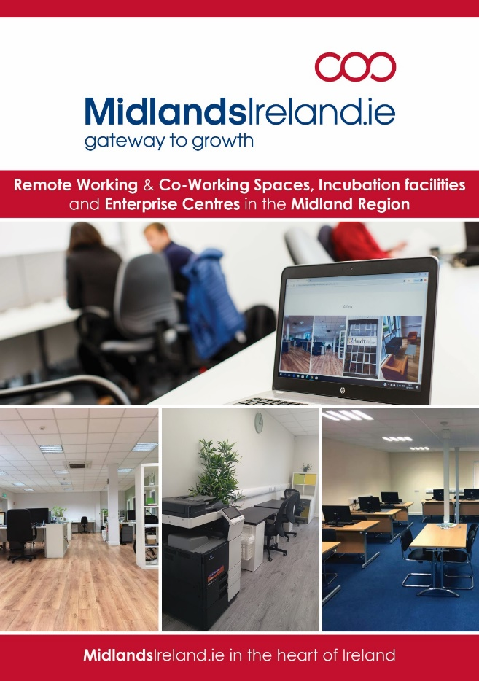
WG4 – Marketing the Region
Being progressed under the Midlands Regional Enterprise Plan to 2020, Objective 4: Enhance the collective offering of the Midlands as a place to live, work and invest in.
Audit of Co-working Space in the Region
Relocation Survey
Development of a Value Proposition for the Midland Region
Establishment of Team Midlands
National Conference Creating Business Opportunities from Climate Change

