Slide 1
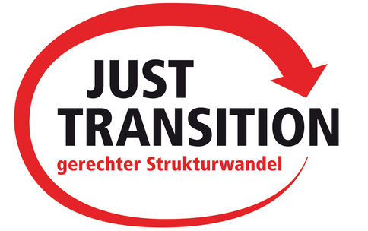
Trade Unions and Climate Policy: Managing Just Transition
Building a Just Transition –
ICTU Major Conference Tullamore
Jan Philipp Paprotny
Policy Officer for Environment, Climate and Sustainability

Slide 2
1 | About DGB
2 | Current Situation and Challenges
3 | Overview and Experiences in Germany
4 | The Concept of Just Transition

Slide 3
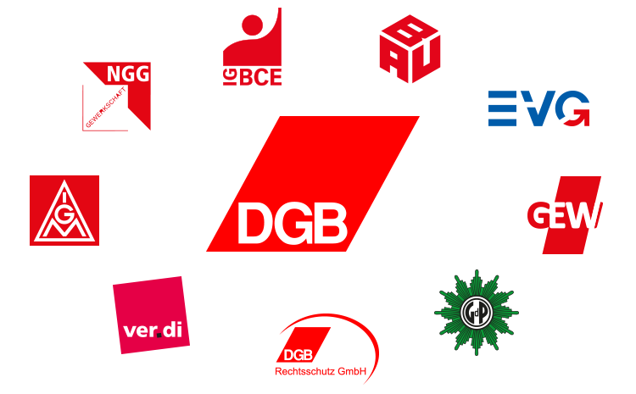
About DGB
The Confederation of German Trade Unions (DGB) is the umbrella organisation of German trade unions
8 trade unions:
~ 6 million members

Slide 4
Historical Emissions
Worldwide 35,755
in million tons
2016
Source: European Commission (EDGAR) 2018
Notes:
climate change is real and anthropogenic / human made
increasing temperature since industrialization around 1.2°C
massive rise in CO2 emission and still increasing
German is accountable for 2% of overall emission
The per capita emission in industrial countries is higher than in the global south, therefore we have a historical responsibility
CO2 reduction has limited influence regarding the worldwide emission
But: When we succeed to shape the just transition / bring together climate action with prosperity
➔ Role Model / best practice ➔ good argument for a first mover
And support other countries: transfer of technologie and climate financen

Slide 5
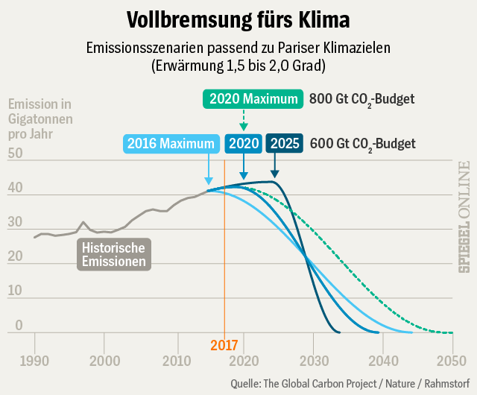
Challenges
Emission Scenarios matching the Paris Climate Targets
(from 1.5 to 2.0 degrees)
emission in gigatons per year
historical
emissions
Source: Spiegel-Online, Global Carbon Project, Rahmstorf 2018
Notes:
all evidence and scientists show that we have to act, otherwise the consequences of climate change will cause intolerable damage to the people
Paris-Agreement: keep the increase in global average temperature to well below 2 °C above pre-industrial levels; and to limit the increase to 1.5 °C, since this would substantially reduce the risks and effects of climate change
It’s an international legal agreement, DGB supports it ➔ the way into a low-carbon future has no alternative
workers know there are no jobs on a dead planet
the question is how to achieve this goal: different ideas and approaches around the world and uncertainty about the exact reduction path is needed
We need to act coordinated and collectively, climate change and its effects don’t stop in front of borders!

Slide 6
Germany’s Climate Action Plan 2050
climate goals:
2020: min. 40%
2030: min. 55%
2050: 80% - 95%
-40%
Source: BMU 2019
Notes:
The was invented by a broaden stake holder platform (together with trade unions)
to achieve the Paris-Agreement 2050, Germany aims to reduce its emission by 80% to 95% until 2050 compared to 1990
The German climate action plan provides sectoral goals until 2030
Germany climate goals: 2020 min. 40%, 2030 min. 55%, 2050 80%-95%
those goals are indicative (Anm. nicht verbindlich), but underline the scope of the emission reduction within the whole economy
energy, industry, buildings heavily reduced since 1990 but still have long way to go
for the energy sector the government introduced a commission on how to achieve its target for 2030 and how to shape the transition
the buildings sector does currently not show enough reduction. We still need to find an answer how to decarbonize the buildings sector
in the transport sector it will be a great challenge to achieve the reduction targets. The emissions even raised by 5%!
2017: Germany reduced emissions by 30,8%
Good but not “on track”: Estimations for 2020 is 32%: Therefore gap 8%
Studies also estimated gap for the 2030 goals (616 million tons CO2) ➔ costs of 31 – 62 billion euro (price 50 – 100t / CO2)

Slide 7
„Coal commission“
Notes:
Coal commission ➔ official growth, structural change and emplyoment ➔ means more than just phasing out coal
Members of the commission:
31 members from diffrent groups (8) (representativs): affected regions (7), sientists (5), energy industrie (4), envirmonetal organisations (3), federal parliament (3), administration (1), buisniness and industry (5) & trade unions (3)
The mandate asked for recommendations which include:
Concrete proposals and perspectives for new, future-proof jobs and the affected regions
Investments in the regions and economic sectors affected by structural change
Measures to reliably achieve the 2030 energy sector target
A comprehensive impact assessment
A plan to reduce and eventually stop coal-fired power generation (phase out)
Measures in the energy sector that contribute to closing the gap in achieving the 40% reduction target as much as possible
More than a half year (8 month)
Output 280 pages:
27 yes and 1 no vote ➔ agreemnt over all actores

Slide 8
Results of „Coal Commission“
acceptable path to politically desired end of coal-fired power generation in 2038 (with option of 2035)
climate goals in the energy sector are met
but: no simple shutdown logic
3 periods: 2018-2022 (-12.6 GW), 2023-2030 (-25.6 GW), 2038
increases consistency of the energy transition
adequate social protection creates security for employees
actively shaping of the structural change creates new perspectives
compensation of higher electricity prices maintains competitiveness
reasonable comprehensive package
Notes:
The report is a reasonable and comprehensive package
It shows an acceptable path to politically desired end of coal-fired power generation in 2038, with option of 2035
Climate goals in the energy sector are met: 3 periods of shutdown
climate goals in the energy sector for 2030 will be met
But: it does not contain a simple shutdown logic. It increases consistency of the energy transition by introducing checkpoints on preconditions for a shutdown
Monitoring-checkpoints with a review in 2023, 2026, 2029 and 2032 based on whether or not defined criteria are met:
renewable energies target (65 % by 2030) ➔ black outs
electricity grid expansion / electricity storage capacities
combined heat and power
security of supply / affordable electricity prices for industry and households
creation of new value added and employment
achieving climate goals in the energy sector
If the criteria are not met the government has to act accordingly.
supervision by independent expert panel
adequate social protection creates security for employees
No business-related lay-offs in mining and power plants
Compensation of lost wages and pension deductions
Adjustment allowance as a bridge to retirement for older employees (early retirement)
Qualification programs
Placement of employees in new, good work
In shutting down process, participation of the trade unions and co-decision bodies Accompanying collective bargaining agreements
Active shaping of the structural change creates new perspectives
Objective: To create high-quality jobs and value creation to the same extent as they will be reduced
➔lignite mining regions and hard coal locations
40 billion Euros over a period of 20 years for structural aid
Settlement of federal authorities and research institutions
Involvement of local social partners
An immediate action program ➔ the affected regions are / weak economy situation ➔ federal election this year ➔ right-wing-party
compensation of potential electricity price increases leads to higher competitiveness

Slide 9
Structural Change in the Energy Sector
Job losses through rationalization as a result of reunification and liberalization of the energy market as well as the phase-out of hard coal mining
Source: BMWi 2017
The energy sector and the definitions by the Federal Statistical Office encompasses single economic sector but not the related economic areas that depend on them.
Notes:
A look back:
massive job losses in the energy sector through 1. rationalization as a result of reunification and 2. liberalization of the energy market and 3. the phase-out of hard coal mining
The phase-out of hard coal mining was completed by the end of last year
More than 200.000 jobs were lost in the energy sector since the 90s
Through the energy transition the structural change in the energy sector is further accelerated. Established business models and structures are being challenged
Lessons from the phase out of hard coal mining:
The exit has been made socially acceptable in social dialogue with the trade unions➔ there was no operational dismissal “No worker were left behind”
Money has been provided for social plans, infrastructure building, education and industry
Plenty of time was scheduled so that social plans could be developed and implemented over the long term, and business settlements could be established (50years)
Negative aspects:
The regions are still facing structural change
There is still high unemployment in some regions. The unemployment rate in the Ruhr area is 8.9%, much higher than the NRW average of 6.6% (as of March 2019), the highest in the region. The unemployment rate in Duisburg is particularly high at 11.1% or Gelsenkirchen 12.5%
There is no blueprint for structural change, so it is difficult to draw analogies:
A few factors: success depends on the regional economic power and economic situation, public support, existing infrastructure, the available amount of time for structural change, public acceptance
The progressing structural change in the energy industry and beyond is a major challenge
The energy transition is a driver for structural change also in other industrial sectors (e.g. mechanical and plant engineering)

Slide 10
Importance of Industry
Source: worldbank 2019
Notes:
we have to prevent de-industrialization both in Germany and the EU
share of GDP created by the industrial sector in Germany: 26,
.1 % (2017) (in comparison: EU average is around 19.6%)
➔ Jobs 6.2 Million workers, energy intensive industries 800.00 direct / 1.6 million indirect
strong industry brought us well through the global economic crisis
key sectors like chemical industry, mechanical engineering or the automotive industry are characterized by collective agreements, decent salaries, and thus contribute to distributive justice and macro-economic stability
Existing strength should be expanded and used to solve social and ecological problems
It’s the enabler for renewables and the sustainable development
It delivers basic elements such as steel for wind turbines, concrete for the foundation; chemical industry supplies the basic materials for battery cell production
It’s the base of our prosperity
Positive interactions with other sectors lead to employment (suppliers, maintenance)
we support an active approach to industrial policy
we support that Peter Altmaier’s National Industrial Strategy 2030 put industrial policy back on the government’s agenda and started a discussion on industrial policy that we want to take part in

Slide 11
Development of RE in Germany
65%*
30%*
*German Targets
for 2030
Source: AGEE-Stat 2018
Notes:
Huge transition within the energy sector. Germany raised the share of renewables (in electricity consumption) up to 38 %
The goal until 2030 is to raise the RE share in electricity consumption up to 65%. We are on a good way to succeed. But we are at a turning point at the moment. The government has to make sure the investments in wind and solar will continue so we achieve this goal
That causes a lot of change for the production, the consumption, the consumers and as well the distribution of electricity (electricity grids, fluctuating supply from renewables)
The energy transition (which still goes on) was and will cause high costs. Nevertheless, we had a massive decrease in cost for electricity production from renewables. Meanwhile new renewable power plants have equal or lower electricity production costs than conventional power plants. (Doesn’t solve problems of distribution, supply etc., but shows success)
Considering the whole energy consumption, including heat, transport, electricity, industry etc. the efforts are even bigger and the costs are higher

Slide 12
Employment in the RE Sector
2016
2014
2010
2005
2000
Overall Jobs RE
Source: BMWi 2018
Notes:
The energy transition can lead to an expansion of employment along the complete industrial value chain and the service sector.
Over 300.000 jobs were created in the sector of renewable energies in Germany; however: Since 2013 the employment rates have been decreasing
The crisis of the German photovoltaic industry lead to 50,000 to 80,000 jobs lost within one year
Often lower working standards than in classic industries
Fight for better working conditions, founding of works councils and collective bargaining agreements since early 2000s
Political framework for renewable energy industry was hindering sustainable buildup of employment and union involvement
Lack of supporting industrial policies
Incoherent support policies for renewable energy lead to downfall of solar industry -> union involvement ended before it could begin
Switch from feed-in tariffs to bidding system creates more economic pressure which leads to pressure on working conditions

Slide 13
Working Conditions in RE Sector
43 % of employees in wind energy businesses work without a collective bargaining agreement
Source: IG Metall 2019
Notes:
“Decent Work“ has to be applied if new jobs are created. The traditional industries are a good example!
Decent Work has to be the precondition for receiving financial state support in order to advance the energy transition. The state must not facilitate bad working conditions in the new industries
“green“ industries in Germany are often dominated by bad working conditions and low wages (i.e. Enercon)
Salaries in the renewable energy industry are lower than in the metal and electrical industry
Employees in the renewable energy industry work on average more than 40 hours a week.
Despite a high degree of identification with their work, only 20% of the colleagues could imagine working at their current company until their retirement
on the positive side: compliance with High standards of work safety
Some companies in the new sectors fight labor unions (Enercon)
Co-determination, collective bargaining agreements and decent working conditions are the answer in order to achieve more job satisfaction among the workers and more competitiveness of the new industries

Slide 14
Working Conditions in RE Sector
Salaries in the renewable energy industry are lower than in the metal and electrical industry
Employees in the renewable energy industry work on average more than 40 hours a week.
Despite a high degree of identification with their work, only 20% of the colleagues could imagine working for their current company until their retirement
Compliance to high standards of work safety

Slide 15
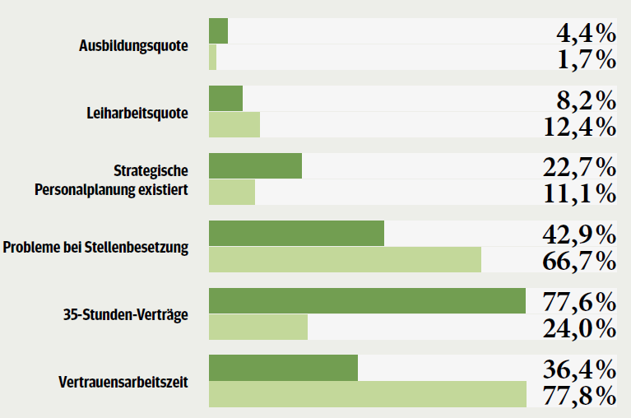
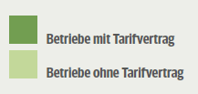
Effectiveness of collective agreements within the RE Sector
Working conditions in the wind sector with collective bargaining agreements are way better
training rates
temporary employment rates
strategic personnel planing
recruitment problems
35-hour-week-contracts
Collective bargaining agreement
trust based working hours
No collective bargaining agreement
Source: IG Metall 2019
Notes:
The survey from IG Metall shows that renewable energy companies with collective agreements have better working conditions
RE-companies with collective agreements have lower temporary employment contracts, higher training rate, lower labor leasing rate, strategic personnel planning, less recruitment problems

Slide 16
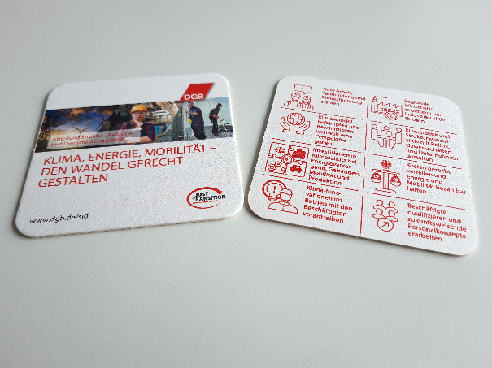
Let‘s Talk About Just Transition!
Notes:
Our answer to structural change is Just Transition
It has been introduced by Trade Unions and anchored in the preamble of the Paris-Agreement
Economies, regions, sectors, companies and employees are in the middle of structural change, which is shaping not only climate protection but also by digitalization, urbanization, individualization and demography
Such profound change is a major challenge and cannot be left to itself. Markets! On the contrary, it must be actively shaped by employees, companies and the state. The goal must be to prevent job losses and to create new, high-quality jobs
Just Transition is understood by many social and political actors as a way to simply soften social hardships that arise through climate protection. We think it is far more than that
At the heart of equitable structural development must be the question of how to exploit opportunities for new, quality employment and economic growth in the course of co2-neutral production. It must also be about strengthening the competitiveness and innovation capability of the industry and further developing value chains and jobs in compliance with ambitious climate goals.
Therefore, high investments are needed. For Germany, a BDI-study (“climate paths for Germany”, federal association of German industry) estimated overall costs of 1.5 trillion Euros to reach the 80% Goal by 2050.
The BDI study forecasted a slightly economic overall surplus without international coordination. With an international coordinated climate policy a strong economic surplus.
All these investments are investments into our future with a payoff
It could be used to overcome crises and stimulate the economy (especially in Eastern-Europe or Rust Belt in USA)
Investments must be made in areas e.g. power grids, energy storage, battery cell production, innovative production ways, use of electricity in other sectors like buildings and mobility
Well-qualified employees are an essential prerequisite. Local workers will apply and implement the innovative concepts and systems. They know their company and its processes best.
High investments in qualification programs for workers as well as ensuring lifelong education are needed.
Workers must be an active part of this process of transformation. Workers are affected and drivers for change at the same time. Shaping a just and successful transition can only happen with workers and not against them.
The people affected by the structural change must not be disappointed and left behind. If that happens, it leads to rejection. The policies of Trump and Brexit are exemplary expressions of what can happen when parts of the population feel left alone.
Same situation in Germany with a new far right party. They deny climate change and try to give workers easy answers. Problem: the government doesn’t reach or necessarily have the trust from people.
Trade union have key role! We can explain causalities to workers, act transparently, build trust, offer security. Solidarity among workers is crucial.
The Just Transition concept can bring conflict of objectives (Zielkonflikte) together

Slide 17
Thank you for your attention!
Jan Philipp Paprotny
Bundesvorstand
Abteilung Struktur-, Industrie- und Dienstleistungspolitik (SID)
Henriette-Herz Platz 2
10178 Berlin
30 240 60 303
janphilipp.paprotny@dgb.de
Notes:
The DGB and its member unions are currently organizing a broad societal dialogue - a dialogue for the future. It covers a variety of topics and societal issues
We put our main preconditions for a successful structural change on a coaster in order to discuss them over a glass of beer.

Slide 18
Backup

Slide 19
Germany‘s Climate Action Plan 2050
Source: BMU 2017

Slide 20
Gross Electricity Generation in Germany 2017
Source: AGEB 2018

Slide 21
Germany‘s Climate and Energy Targets
 |  | 2017 | 2030 | 2050
Climate targets | Reduction of greenhouse gas emissions – compared to 1990 | - 27 % 905 MT | - 55 % (543-562 MT) | 80/95 %
- By sector | Energy industry | 328 MT | 175-183 MT | -
 | Industry | 193 MT | 140-143 MT | -
 | Buildings | 130 MT | 70-72 MT | -
 | Mobility | 171 MT | 95-98 MT | -
 | Agriculture | 72 MT | 58-61 MT | -
Renewable energy targets | Share of electricity | 31,6% | 65 % | 80 %
Energy efficiency targets | Reduction of primary energy consumption | -6,5 % | - | -50 %

Slide 22
Share of coal in electricity generation
Share of coal: 57 %
Share of coal: 50 %
Share of coal: 41 %
Share of coal: 35 %
Source: AGEB 2019

Slide 23
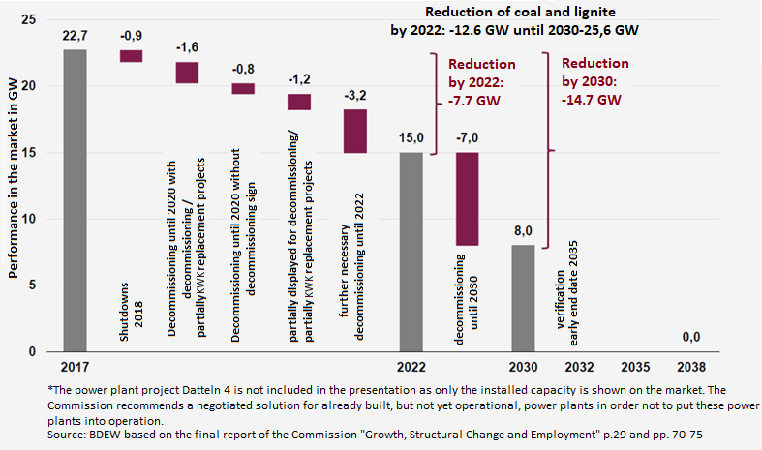
What does the report mean for the energy sector and industry?
Reduction of hard coal-fired power generation

Slide 24
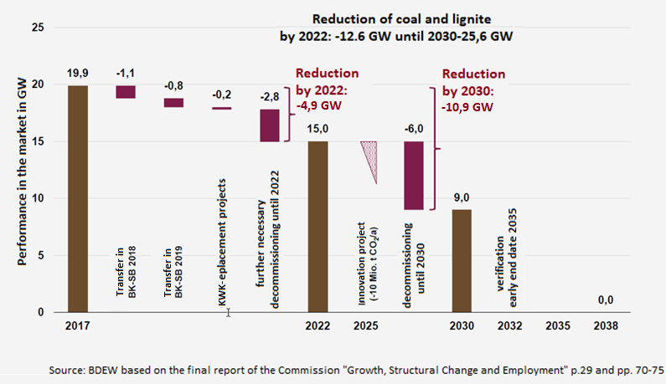
What does it mean for the energy sector and industry?
Reduction of lignite-fired power generation

Slide 25
What does the report mean for workers?
A comprehensive package for the protection of employees
No business-related lay-offs in mining and power plants
Compensation of lost wages and pension deductions
Adjustment allowance as a bridge to retirement for older employees
Qualification programmes
Placement of employees in new, good work
Participation of the trade unions and workers councils
Accompanying collective bargaining agreements

Slide 26
What does the report mean for structural change?
Structural change is being actively shaped – in cooperation with social partners
Target: To create high-quality jobs and value creation to the same extent as they will be reduced
Consideration of lignite mining regions and hard coal locations
40 billion Euros over a period of 20 years for structural aid
Settlement of federal authorities and research institutions
Involvement of local social partners
An immediate action programme starting now

Slide 27
What does it mean for the energy sector and industry?
No unconditional shutdown logic for coal, but conditioned and voluntary
Monitoring-checkpoints with a review in 2023, 2026, 2029 and 2032 based on weather or not defined criteria are met:
renewable energies target (65 % by 2030)
electricity grid expansion / electricity storage capacities
combined heat and power
security of supply / electricity prices for industry and households
creation of new value added and employment
achieving climate goals in the energy sector
If the criteria are not met the government has to act accordingly.
supervision by independent expert panel (unions will be involved)
Secured competitiveness
compensations for losses of operating companies
compensation for increases in electricity prices for companies and private househoulds

Slide 28
Members of the commission
31 members from different groups
Source: Agora Energiewende

Slide 29
What‘s next?
Implementation by the federal government begins now
Critical debate among coalition parties – so far no consensus on the whole package
Draft law for structural aid in April
Draft law for energy and climate policy measures in autumn
First monitoring in 2023 by independent expert panel

Slide 30
The timeline
Coalition Agreement March 14th, 2018
Mandate by the government June 6th, 2018
1st meeting 26th June 2018
Trips to lignite mining regions from September to October 2018
Intermediate report on structural change
Intensive work of the working groups November to December 2018
Last meeting and final report on January 25, 2019
Now the implementation begins!

Slide 31
-Just Transition- Trade Union Concept
Strengthen participation and leave no one behind
Create decent work and maintain jobs
Transition must be actively shaped by government, companies, trade unions
Anchored in the preamble of the Paris-Agreement
Ensure qualification and lifelong education for workers
High sustainable investments ensure climate protection and profits
Fair cost allocation

Slide 32
Germany‘s Role Regarding Climate Action
reduction of CO2 ➔ limited influence regarding worldwide emissions
role model to and support for other countries
transfer of technologies and policies
climate finance
mitigation & adaptation
just transition
➔ maintain and create prosperity

