Slide 1
Building a ‘Just Transition’
Bord na Móna
John MacNamara, Head of Regulatory Affairs, Bord na Móna
Tullamore, 30th April 2019

Slide 2
EU Climate & Energy Targets (2030) in a nutshell
Across the EU
32.5% improvement in energy efficiency
32% share for renewable energy
40% cuts in greenhouse gas emissions
Ireland
Draft NECP submitted to EU Commission Dec’18
Energy Efficiency 24 – 25%
Renewable Energy 24 -28%
Greenhouse Gas Emissions reductions – only 38% of 2030 target achieved since 2005
Notes:
EU emissions trading system (ETS) sectors will have to cut emissions by 43% (compared to 2005) – to this end, the ETS has been revised for the period after 2020
non-ETS sectors will need to cut emissions by 30% (compared to 2005) – this has been translated into individual binding targets for Member States.
A binding renewable energy target for the EU for 2030 of at least 32% of final energy consumption, including a review clause by 2023 for an upward revision of the EU level target.
The original target of at least 27% was revised upwards in 2018.
2017 GHG EPA figures 1990 -2017 ---- 1990 figure was 55.4 total
2005 69.5m (ETS +nonETS)
2017 – 60.7 (16.9 & 43.8) --- 8.7 saved by 22.6 required for 2030; hence if 22.6 = 40% then 8.7 equals 15%
Ireland 2020 targets
RES –
EE
GHG

Slide 3
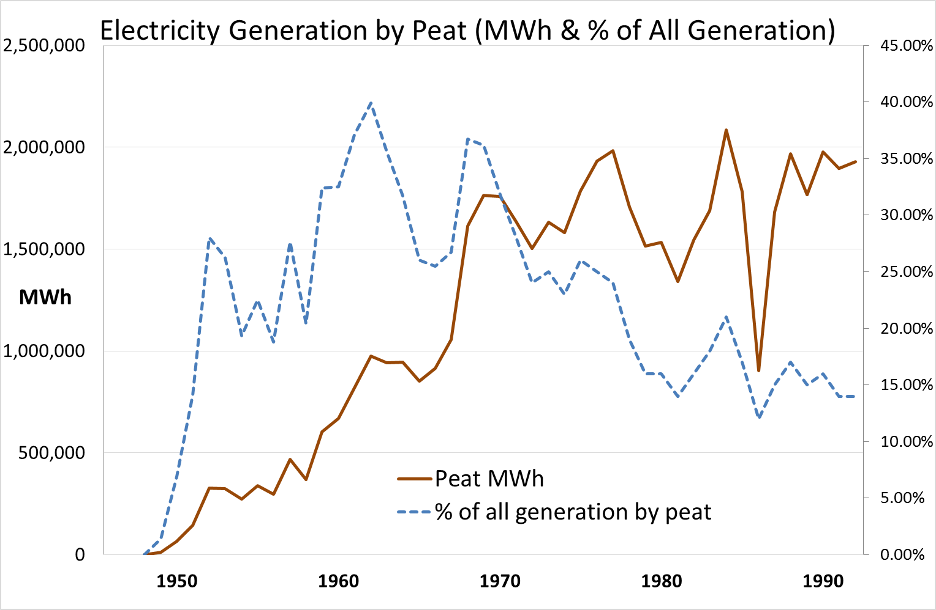
Notes:
Today the three peat stations deliver approximately 7% of electricity (2.4TWh) but responsible for circa 20% of GHG in energy secotr

Slide 4
The Transition – What’s Needed?
Support employees leaving the business
The existing non-peat related activities must continue to grow
Support for the structural transformation of the peat harvesting region(s)
Mobilisation of private forestry and biomass supply chains;
Establishment of new energy crops
Development of new enterprises on the existing peatlands:-
Innovative uses for the peatland assets
Rehabilitation of peat lands including beneficial contributions to LULUCF

Slide 5
270
Tax & VR Figures
6 events, 7 locations
Tax Briefings
5 events, 4 locations
Crossroads Workshop
10 events, 6 locations
CV, Interview Prep, career coaching
25 events, 4 locations
Job Hunting, SYOB
8 events, 4 locations
Info, ETB & Advice Clinics 6 events, 6 locations
Recruiter Seminars
2 events, 2 locations
Retirement Courses 4 events, 1 location
156
66
203
101
Events
Delivered
144
73
71
How many engaged up to 10th April 2019
41

Slide 6
The Transition – What’s Needed?
Support employees leaving the business
The existing non-peat related activities must continue to grow
Support for the structural transformation of the peat harvesting region(s)
Mobilisation of private forestry and biomass supply chains;
Establishment of new energy crops
Development of new enterprises on the existing peatlands:-
Innovative uses for the peatland assets
Rehabilitation of peat lands including beneficial contributions to LULUCF

Slide 7
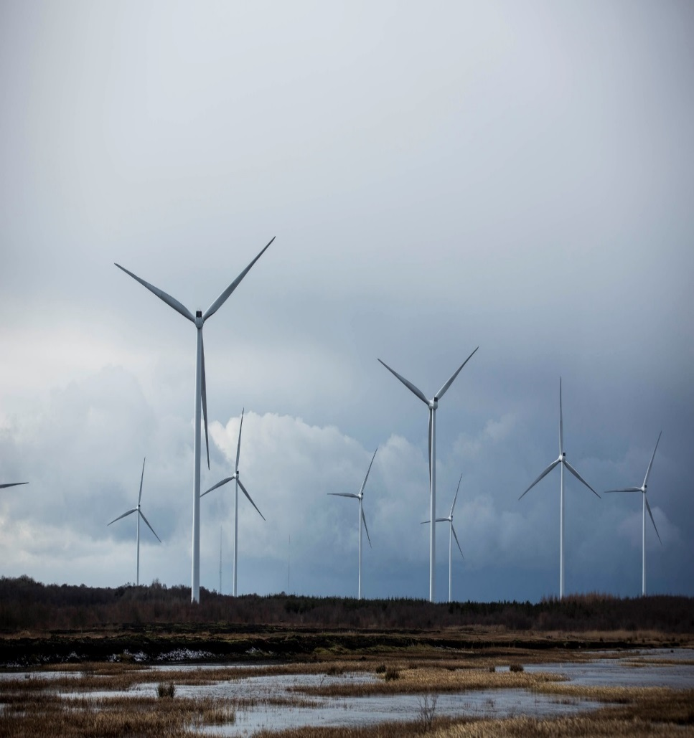
Renewable Energy Pipeline
Bord na Móna has developed & operates 185MW over 4 windfarms
Another 90MW windfarm to be commissioned in 2019
Further 340MW in the consenting process for 2025
Additional 350MW in the pipeline for 2030
70MW of PV planned for 2021
Additional 400MW of PV in the pipeline for 2027

Slide 8
AES - Waste Collection and Recycling

Slide 9
The Transition – What’s Needed?
Support employees leaving the business
The existing non-peat related activities must continue to grow
Support for the structural transformation of the peat harvesting region(s)
Mobilisation of private forestry and biomass supply chains;
Establishment of new energy crops
Development of new enterprises on the existing peatlands:-
Innovative uses for the peatland assets
Rehabilitation of peat lands including beneficial contributions to LULUCF

Slide 10
Peat Power & Biomass in Ireland
Extended plant
Outage (2015)
Notes:
Largest single (dispatchable) renewable plant in Ireland.

Slide 11
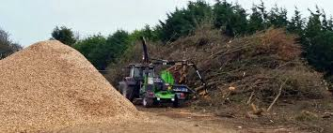
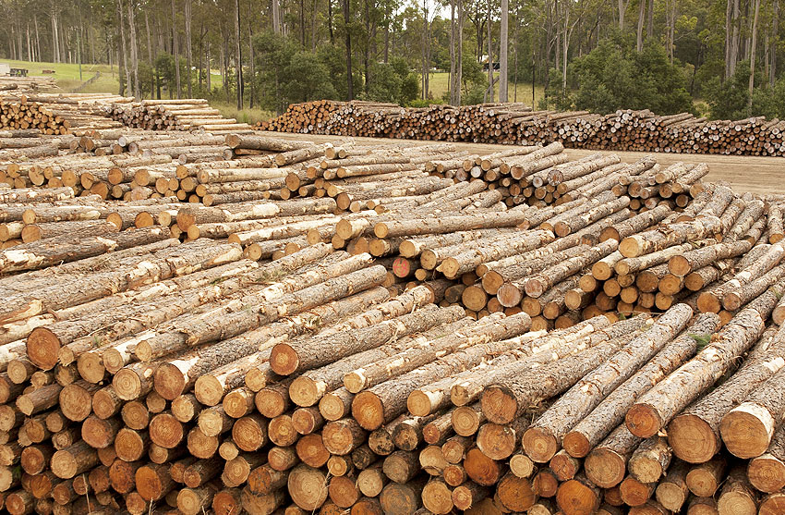
Forestry Thinning's & Residues
Potential for an additional 1.1 PJ per annum
Notes:
1.1PJ – 305 MWht

Slide 12
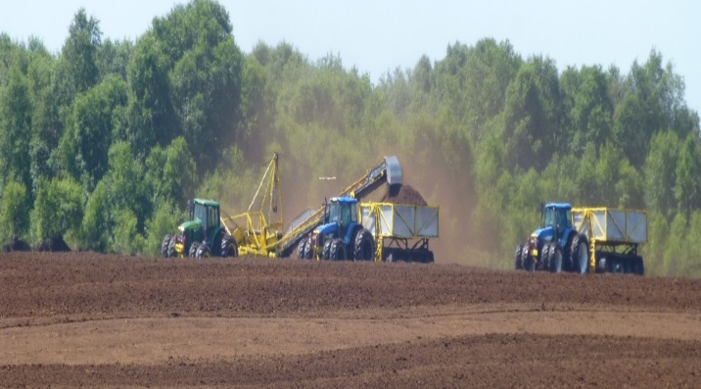
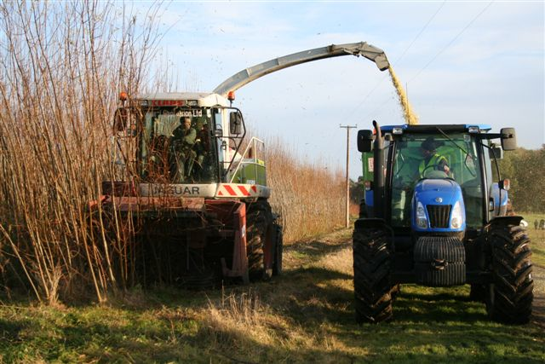
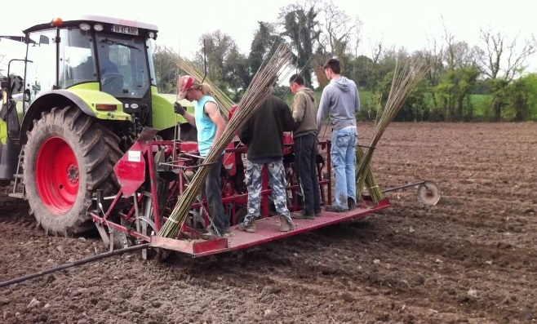
Willow Establishment
There is under utilised land ideally suited for willow growing located within 100km radius of each power plants
The job creation and income potential from Willow is significant and could help offset the impact of transitioning away from peat
Establishment funding for growers critical to success
13,000ha. of willow would provide 2 PJ of fuel per annum
Notes:
2PJ - 555,555MWh th

Slide 13
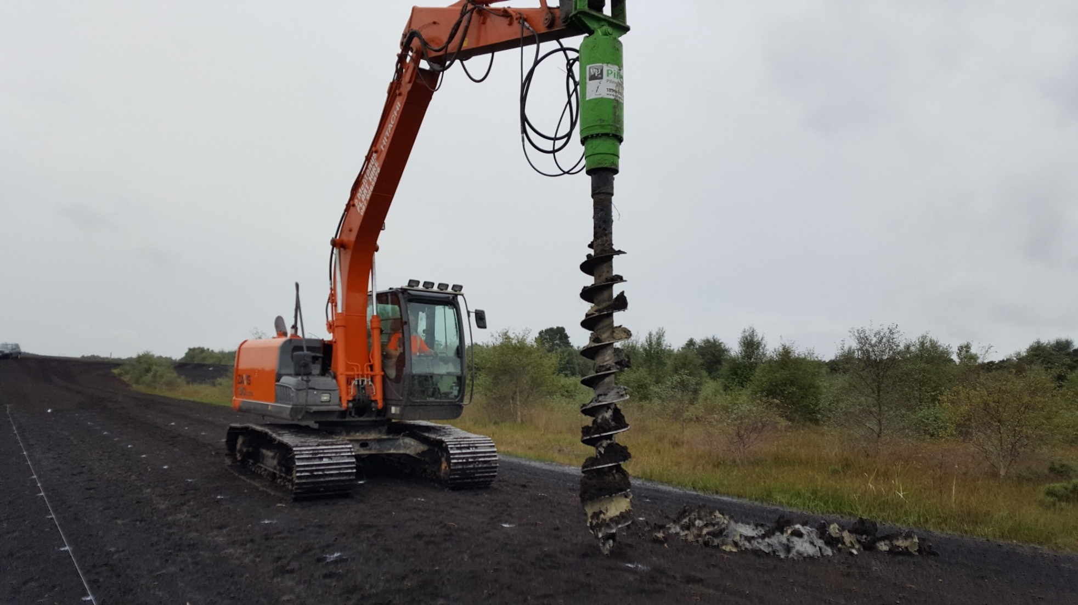
New Biomass trials on Peatlands

Slide 14
The Transition – What’s Needed?
Support employees leaving the business
The existing non-peat related activities must continue to grow
Support for the structural transformation of the peat harvesting region(s)
Mobilisation of private forestry and biomass supply chains;
Establishment of new energy crops
Development of new enterprises on the existing peatlands:-
Innovative uses for the peatland assets
Rehabilitation of peat lands including beneficial contributions to LULUCF

Slide 15
Aquaculture VISION
WIND TURBINES
MARKET
FISH FACTORY
PONDS
LABOUR
VEGETATION
PONDS
DUCKWEED
SPLIT PONDS

Slide 16
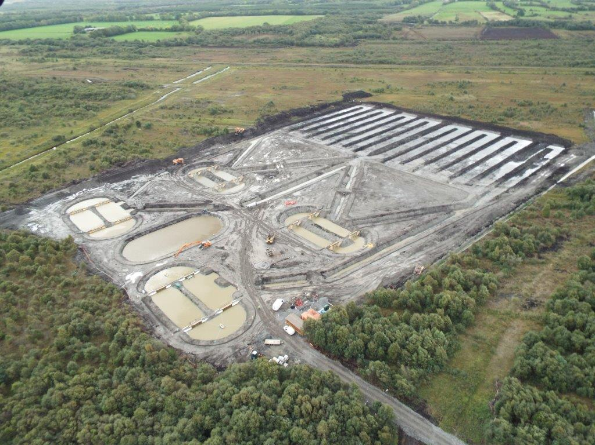
Aquaculture – Pilot Development
Water Reservoir
Duckweed Treatment Ponds (1.6 ha)
Fish Ponds
Notes:
BnM currently undertaking a trial for 20t fish output facility which is based on 1.2 ha
Discuss the 20 tonne pilot trial briefly
4 fish ponds – 3 with perch and 1 with rainbow trout
The duckweed system will be connected to the ponds which will act as a water treatment facility
Explain the water flow direction – use of paddlewheel – powered by turbine 18?
It will be a complete natural cycle and hopefully produce fish of organic standard

Slide 17
MóNA HERbs vision
GREENHOUSE
NATURAL HERB GROWTH
JOB
CREATION
BIRCH WATER
WIND TURBINES
BIRCH WOODLAND
PROCESSING FACILITY
HERBAL PRODUCTS
PROCESSING FACILITY
SHELTERED HERB GROWTH

Slide 18
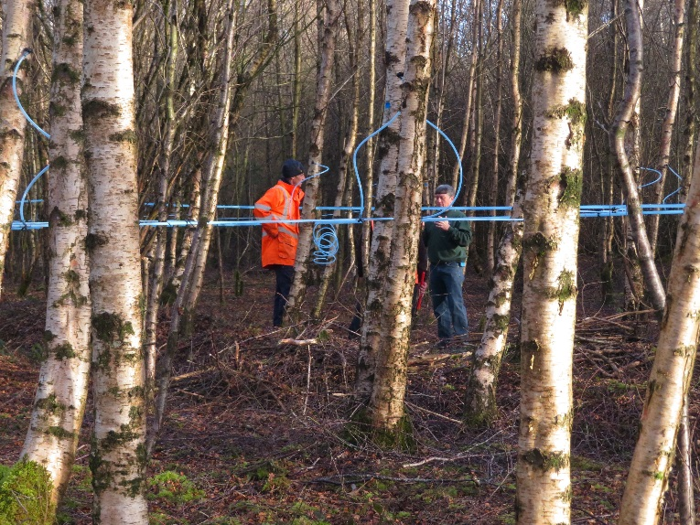
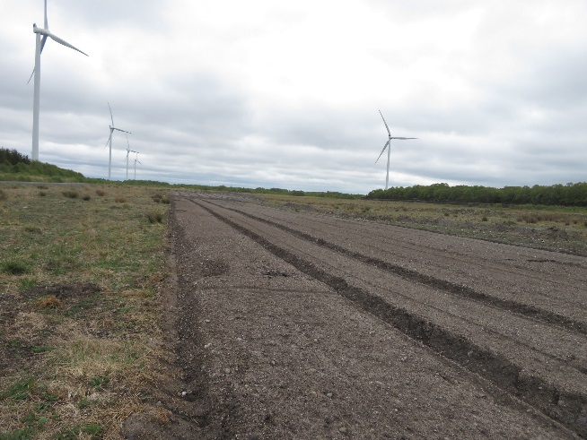
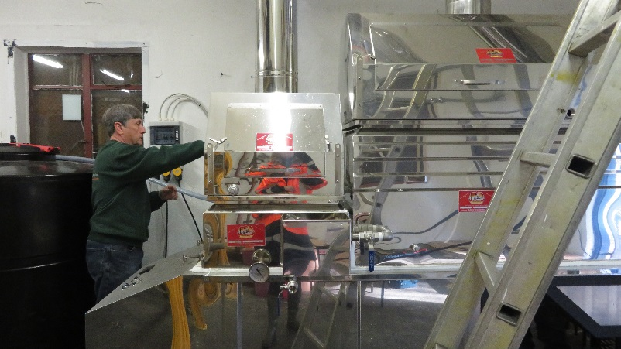
MóNA HERbs vision
GREENHOUSE
NATURAL HERB GROWTH
JOB
CREATION
BIRCH WATER
WIND TURBINES
BIRCH WOODLAND
PROCESSING FACILITY
HERBAL PRODUCTS
PROCESSING FACILITY
SHELTERED HERB GROWTH

Slide 19
In Conclusion
Bord na Móna & the Irish Midlands see ourselves as a Region in Transition
A Transition that must be Just socially, environmentally and economically
Our Strategy is to Respond to the challenge
Need stakeholders to understand:
this transition will take time
that external ‘assistance’ will be needed
political, institutional & financial support will be required
Notes:
Mention
consolidate & simplify the traditional business
Extend the core – PowerGen & RR
Scale the new -

Slide 20
Thank you for your attention

