Slide 1
Just Transition for Climate Ambition
From Paris to Katowice
The international context
Tullamore – Ireland – 30 April 2019

Slide 2
What is a Just Transition?
Just Transition is based on social dialogue between workers and employers,
often governments, and sometimes communities.
A sector, region or economy-wide process that produces the plans, policies and investments so that:
Everyone has social protection;
All jobs are decent;
Emissions are low or at zero;
Poverty is eliminated; and
Communities are thriving and resilient.
Just Transition includes both measures to reduce the impact of job and livelihood losses and industry phase-out on workers and communities, and measures to produce new, low emissions and decent jobs and livelihoods as well as healthy communities.
It’s defined in the UN International Labor Organization’s global Just Transition guidelines.
Defined in the UN International Labor Organization’s global labor guidelines.
It’s a key requirement of the Paris Agreement on climate change and is reflected in the Sustainable Development Goals.

Slide 3
ITUC, ETUC and the Just Transition Centre
The International Trade Union Confederation represents more than 200 million workers worldwide in 162 countries.
The European Trade Union Confederation represents working people in EU-decision making and across the region.
The Centre was established by the ITUC and ETUC in 2016. It supports unions and their allies in getting concrete plans for Just Transition.
The Centre helps to get good, concrete plans for Just Transition at different levels: Company and sector; city and state; national; and with investors.
Good plans for Just Transition improve the material conditions of workers and bring down emissions and/or build resilience.
Mobilizing unions
Industrial transformation
Vulnerable workers and communities
Cities and states
Investment

Slide 4
Solidarity and Just Transition
Silesia Declaration
Ministerial Declaration – initiative of COP President and Polish Gvt
In marge of COP24 – Katowice 2018
Ensuring a just transition of the workforce that creates decent works and quality jobs
Stress that Just transition is crucial to ensure an effective and inclusive transition to a low greenhouse gas emission
Underline employement opportunities
Note the importance of participatory and representative process of social dialgue
Implementing Just Transition in Nationally Determined Contributions (NDC COP26)
Transition vary from country to country
55 States + EC
➔ Ireland
4

Slide 5
What workers want to know
What are the new jobs?
How do we get from here to there?
Defined in the UN International Labor Organization’s global labor guidelines.
What does just transition mean for us?

Slide 6
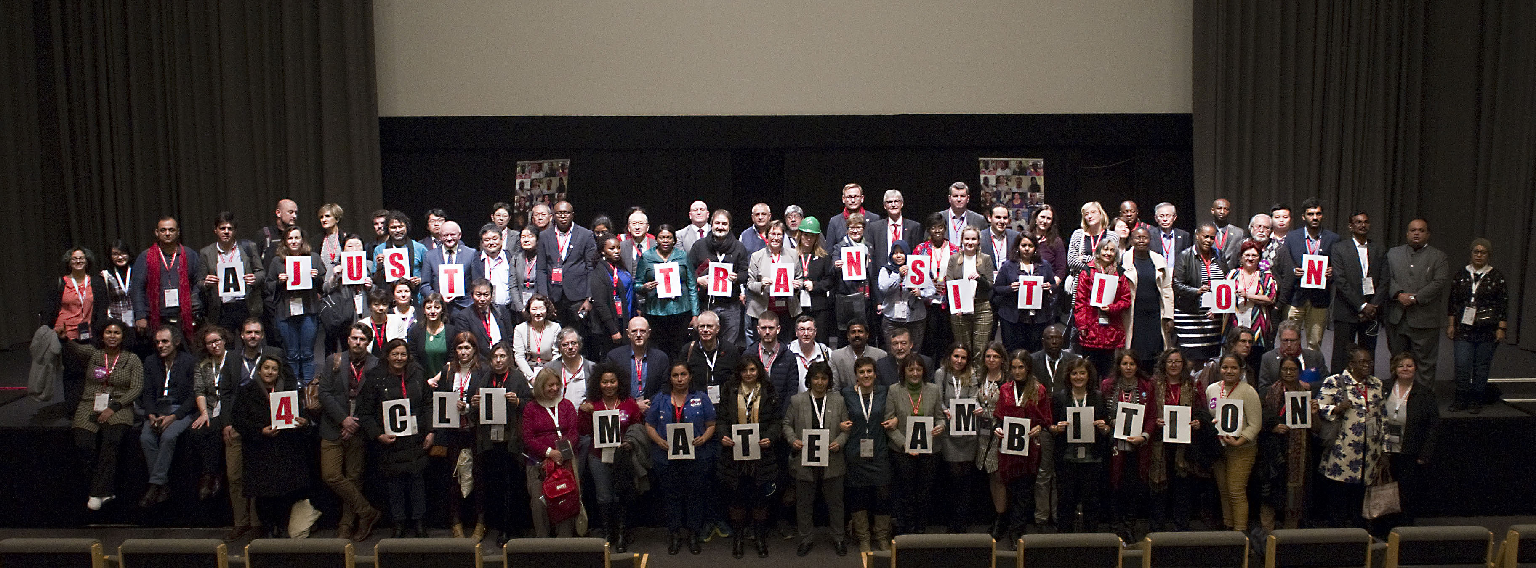
ITUC Congress 2018 - Copenhagen

Slide 7
ITUC Congress - Just Transition
Congress deplores the massive and growing global inequality, and demands a just transition to a digitalised and low-carbon economy (147)
The ITUC demands that all transformation in the world of work take place in the framework of Just Transitions. (148)
Governments must raise their ambition and ensure investment in jobs and Just Transition. (164)
The fight against climate change requires investments in sustainable and lowcarbon technologies. (165)
The ITUC Just Transition Centre can help ensure that unions, government, business, cities and concerned communities can work together and that climate action means green, secure and decent jobs. (171)

Slide 8
Examples of Just Transition

Slide 9
Canada
Canada’s clean-growth and climate action plan
Carbon neutrality by 2050.
Phase out emissions from coal-fired electricity by 2030.
The Just Transition Task Force for Canadian Coal Power Workers and Communities
Labor advocated for and leads the Task Force. Members are union and local government representatives, civil society and experts.
Focused on coal-fired power with 3500 affected workers.
The Commission has produced recommendations that then must be turned into legislation and budget allocations. A formal announcement from the Canadian Ministry of Environment is forthcoming. 35 million CAD for initial work of Task Force.
The Task Force and its work are based on Alberta’s Just Transition process. Measures include expanded unemployment insurance; a bridge to pension for older workers; vouchers for skills and other retraining; agreement from employers to retain, reskill and redeploy workers; grants to communities to help them develop new jobs. Funding comes in part from the province’s CO2 tax.
Notes:
“Canada’s clean-growth and climate action plan Neutral carbon 2050”
Phase out traditional coal-fired electricity by 2030
3500 workers
The Just Transition Task Force for Canadian Coal-Power Workers and Communities
35 millions CAD

Slide 10
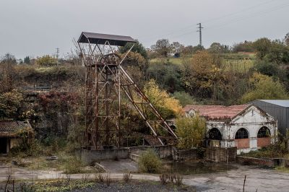
Spain: Plan Del Carbon
Spain’s draft climate law
100% RES by 2050, 70% RES by 2030.
Phase out coal and nuclear power stations by 2030.
Three part plan – Just Transition for coal miners and communities; regional redevelopment; and a national observatory.
Plan Del Carbon – phase one
10 mining fields + all surface mines.
Agreement with the mining and energy unions covering 1677 workers.
The majority will take early retirement.
Paid for via a € 250 million government fund.

Slide 11
And many others places...
New York :
9 GW offshore wind,
supported by/advocated for by unions (Climate Jobs NY)
California
100% renewable and clean energy target, supported by organized labor
Public transport in LA, supported by a coalition of organized labor and community groups.
Victoria Transfer Agreement (Australia)
Unions negotiated a plant closure, mine remediation and worker transfer agreement covering multiple sites, exchanging some wage demands for the agreement.
Liddell Power Plant Agreement (Australia)
Unions negotiated a closure agreement with AGL, the plant owner.
Coal-fired power will be replaced with solar, gas, wind, and distribution
New Zeeland
Just Transition Committee
Nigeria
Project on agriculture and oil
Integrate JT in NDC’s
….

Slide 12
Conclusions

Slide 13
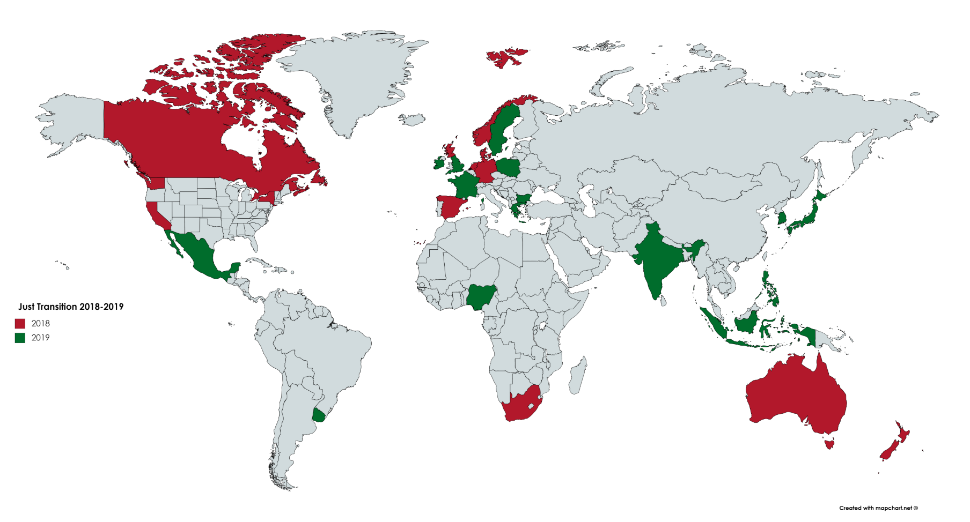
From a concept to realities

Slide 14
Just transition is about workers

Slide 15
Workers are part of the solution!
No « one size fits all »
Learning process
Anticipation vs Reaction
Social dialogue
Investment
Political will
Coherence

Slide 16
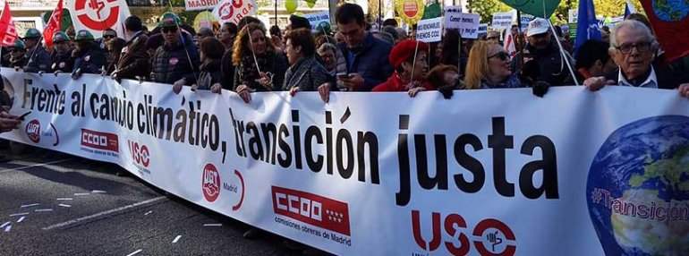
Thank you for your attention
« Public opinion currently supports climate change-fighting efforts, but if working people are left with greater economic security than before, a backclash could be generated »
Carla Lipsig-Mummé
Prof. of work and labour
York University
https://www.justtransitioncentre.org
sebastien.storme@justtransitioncentre.org

