Slide 1
Social Media Seminar
Law, Rights & Policy for Unions
September 15, 2015

Slide 2
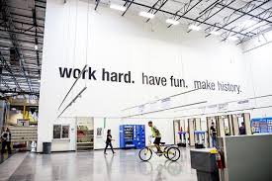
The future is Amazon…?

Slide 3
Union Survey
Only one full time social media officer
Only four trained
Only six had policy and guidelines

Slide 4
Trade Union Bill
Unions must report:
“…..if they plan to use social media, including Twitter and Facebook during their campaign and what they plan to set out (write) on websites and blogs.“ (TUC)

Slide 5
Online content will be monitored….
“…..Employers will argue that unions are responsible for the actions (on social media) of union officials, including full-time officers, branch secretaries and union workplace representatives.”

Slide 6
Unions responsible for all content?
“Will a union member who changes their Twitter profile to reflect their union’s logo be considered to have been tweeting on behalf of the union or of themselves?

Slide 7
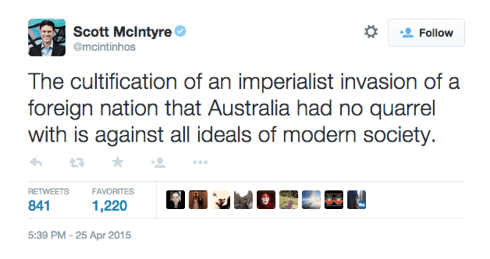
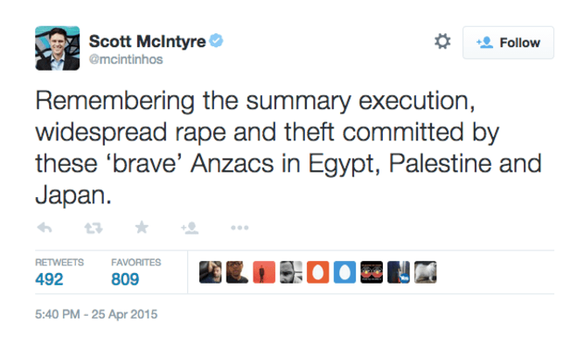
ANZAC Day Controversy

Slide 8
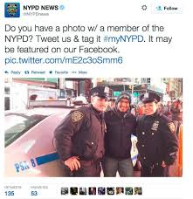
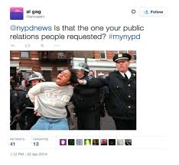
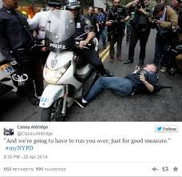
How not to do Social Media……
#mynypd

Slide 9
Not so happy July 4th….

Slide 10
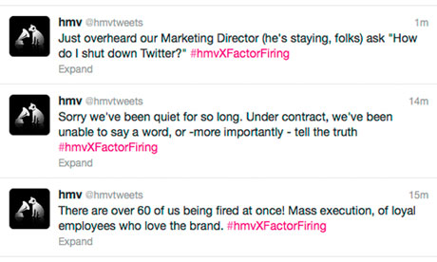
Not his master’s voice…

Slide 11
Guideline essentials
Apply common sense to any policy or guidelines
Ensure people add disclaimers to private accounts
Report abuse/ criticism to designated people
If multiple accounts be clear who uses and has passwords
Designate person with power to delete, shut down
Respond quickly to errors

Slide 12
Four key issues….
Bringing the union into disrepute
Breaching confidentiality
Breaching copyright
Discrimination, bullying, harassment

