Slide 1
The continuing crisis in Irish pensions

Slide 2
This presentation will explore:
The extent of the Defined Benefit collapse
How workers in funded pension plans have lost the pensions they earned and paid for.
The failure of our pension regulation system.
The negation of worker influence over their pension funds by the pretence they are merely ‘consumers’.
The proposed universal pension system
The opportunist increase in the pension age.
Alternative to over priced annuities to ease pressure on DB
Issues on which Congress might campaign

Slide 3
A catastrophic decline in Defined Benefit
Defined Schemes Active members
31/12/06 1,232 269,529
31/3/15 703 137,000

Slide 4
Or to be more specific:
703 – no. of DB plans still in existence Ireland, a reduction of 50%
90% - proportion closed to new members
83% - proportion of those choosing DC for new members
40% - 50% - no. of DB plans closed to future accrual
75% - proportion of those choosing DC for future accrual
Those pensions with no indexation will lose 50% of value over twenty years

Slide 5
Some have learnt nothing from this catastrophe
Workers paid €100 million over 20 years to the Pensions Board to protect their pensions.
The PB regulated trustee behaviour and for the most part ignored the overexposure of Irish pension funds to high risk investments.
The PB also ignored the performance of DC.
Before the crash 66% of Irish pension assets were in high risk equities as opposed to 25% in UK.
The government and the PB insisted on overvaluing liabilities making good DB schemes appear un-sustainable.
With levies and ill-advised misdirected regulation, DB was regulated almost to extinction with workers carrying the losses.

Slide 6
Congress lobbied hard
We fought for a gradual de-risking while PB pressurised schemes into crystallising losses at the bottom of the market. This pressure continues and has been added to by the instance that DB scheme carry significant extra risk reserves.
PB suggested that scheme problems arose from a lack of prudence by trustees and under estimation of risk.
Diligent conscientious trustees have been made the scapegoat.
Congress built a consensus with IBEC, IAPF and SAI for changes in the priority order on wind-up to spread the pain of adjustment beyond the active members to pensioners. This was finally agreed by Government in late 2013 but by that time it was too late to save or even help most schemes.

Slide 7
Representative board nobbled
Consensus of Congress, IBEC, IAPF and Society Actuaries was bitterly resisted by PB executive and senior civil servants.
In the interest of the ‘consumer’ the new Pension Authority is composed of family budget journalists, PRSA salespeople and senior civil and public servants. These people have nothing to lose if DB is regulated out of existence or if DC plans fail to deliver.
Organised workers are not ‘consumers’ but beneficial owners of their pension assets. Yet workers have now no say or input into what happens to these assets.
Workers have not been ripped-off by the pension industry, they have been let down by successive governments and the regulation system.

Slide 8
Higher pension age
The State Pension age rose to 66 in 2014, and will rise to 67 in 2021 and 68 in 2028.
There was no political debate, no consultation with employers or workers representative, and no cost benefit analysis of the measure.
Ireland is going further and faster than any other European country.
Depending on age some workers stand to lose €12,000, €24,000 or €36,000 of their social insurance entitlement
The veteran politicians and senior civil servants (pre- 1995ers) who pushed this through suffer no losses themselves.
No consideration whatever was given to provide for workers working beyond age 65.

Slide 9
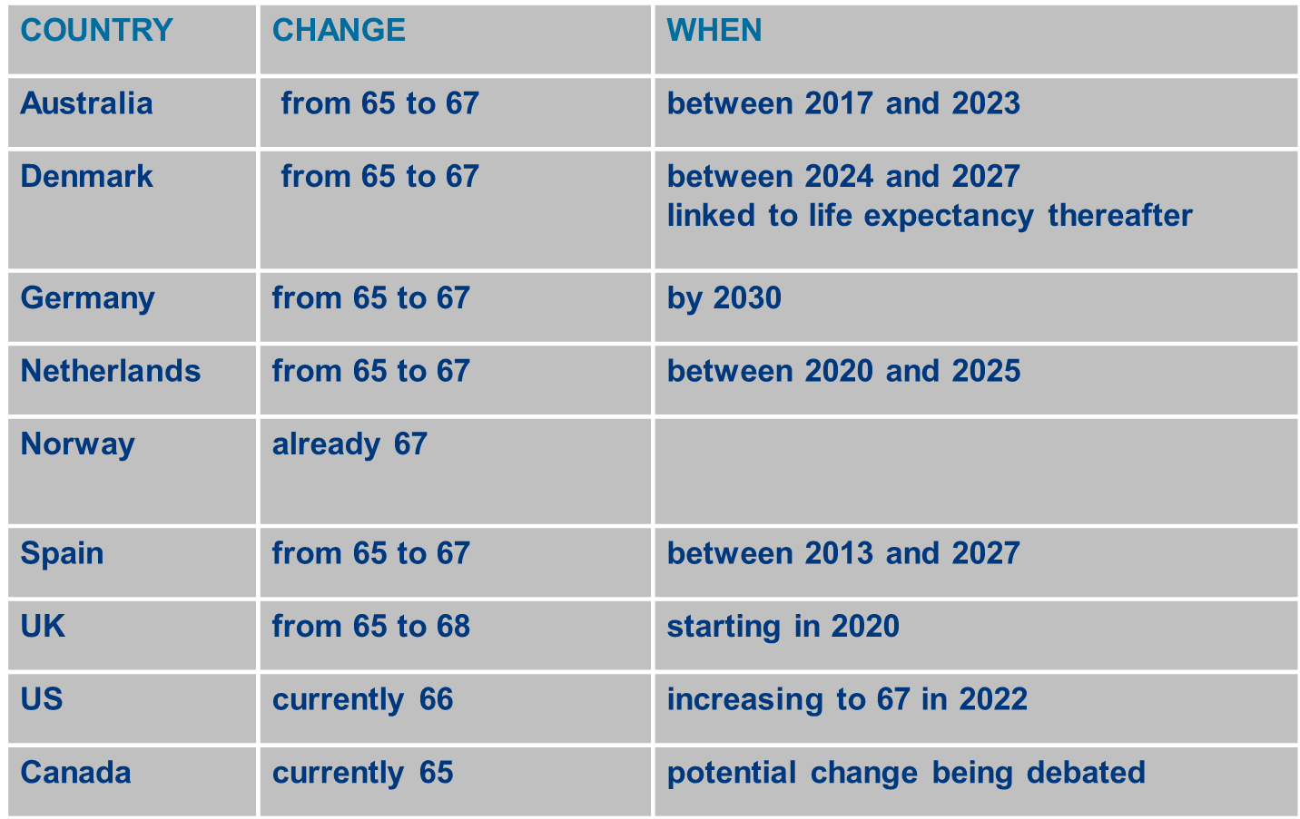

Slide 10
Universal provision and the OECD Report 2013
‘Compulsion is the less costly and most effective approach to increase coverage of private pensions.’
‘Automatic enrolment is a second-best option. Its success depends on how it is designed and on its interaction with incentives in the system.’
Minister is in favour of auto-enrolment.
However this report has been hijacked by Insurance Ireland

Slide 11
The Pension world according to Insurance Ireland

Slide 12
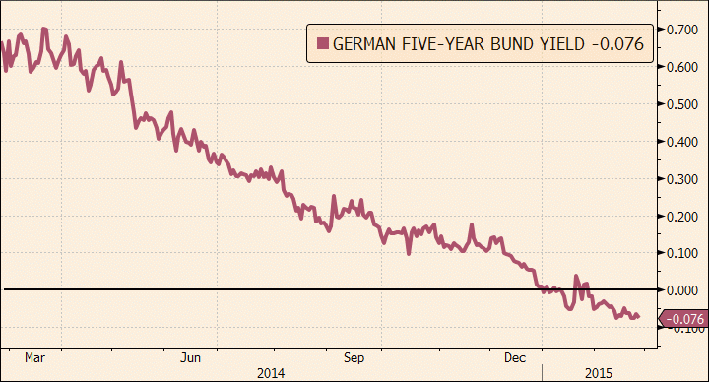
Pension scheme assets are growing but: liabilities continue to soar exponentially

Slide 13
Here’s what’s happened to annuity costs

Slide 14
What this means for DB schemes
With zero bond yields it costs c. €225,000 to buy a pension of €10,000 p.a. for a pensioner aged 70 - almost doubling in cost over 10 years
Assuming 3% yield it costs c. € 175,000 (2012 levels)
Assuming 4% yield it costs c. € 160,000 (2010 levels)
The Pension Regulator insists that schemes are funded by projecting pension liabilities @ zero yield on AAA bonds.

Slide 15
A fairer alternative
The law could be changed so that in the event of wind-up the above trustees could offer a “reasonable” capital value of, say, €150,000 in the form of an ARF rather than pay €225,000 to an insurance company for each pensioner to give them €10,000 p.a.. This would make it easier to meet the funding standard and would likely be very popular with pensioners
Crucially it would leave more money with employees if a scheme was forced to wind-up in a distressed state

Slide 16
For example
Assume 40 pensioners and 40 employees
It is a cruel irony that the current rules not only lead to avoidable wind-ups but also make a bad situation worse by the manner with which they dictate the split of funds.
 | Current Rules | ARF alternative
Fund | €10,000,000 | €10,000,000
Amount needed for pensioners | €9,000,000 | €6,000,000
Amount left for employees | €1,000,000 | €4,000,000
Average pay-out per employee | €25,000 | €100,000

Slide 17
Issues on which Congress should campaign
Push the rise from 66 to 67 our for five more years and only move to 68 with rest of Europe.
Demand protection for workers to allow them to stay beyond 65 ?????
Demand a regulation system which has as a first priority the interests of scheme members in place on the current failed system
Trade Union and Employer representation on Pension Authority
We must ensure that the Insurance Federation plan does not result in a system where the worker takes the risk, the industry takes the profits and the trustees take the blame.

