Slide 1
Francis Doherty, Head of Communications

Slide 2
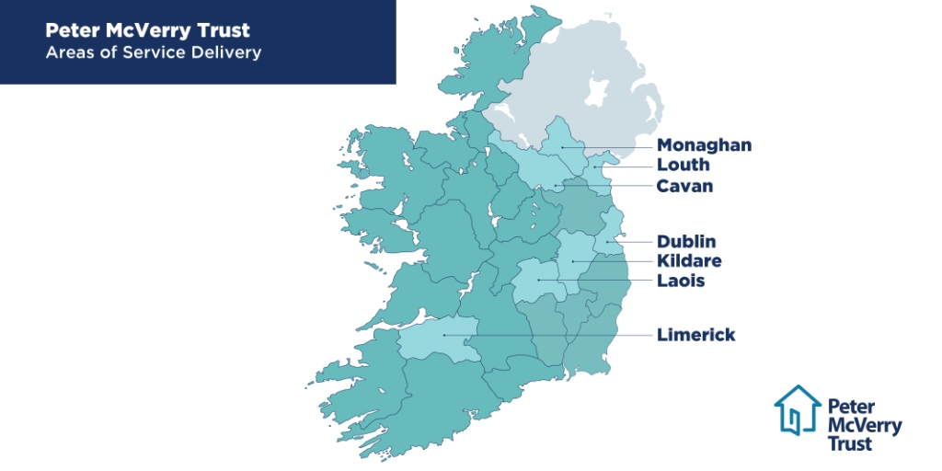
Peter McVerry Trust
About Us

Slide 3
Housing & Homeless Crisis
Current Challenges
Rapid and Sustained Increase in number of people requiring support
Lack of Urgency = Missed Opportunities
- Culture
Growth in PR Policy / Impacts on transparency & accountability
- Housing Exclusion – Single Person – Care Leavers

Slide 4
Housing and Homeless Crisis
Targeted, Evidence Based Interventions
Rural Homelessness
Empty Homes
- Access to Local Authority Land for Special Needs Housing

Slide 5
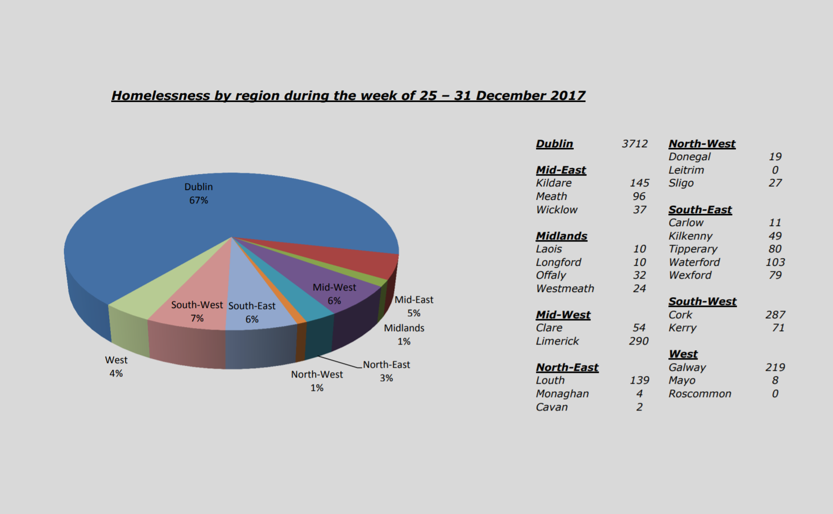
Housing and Homeless Crisis
Rural Homelessness

Slide 6
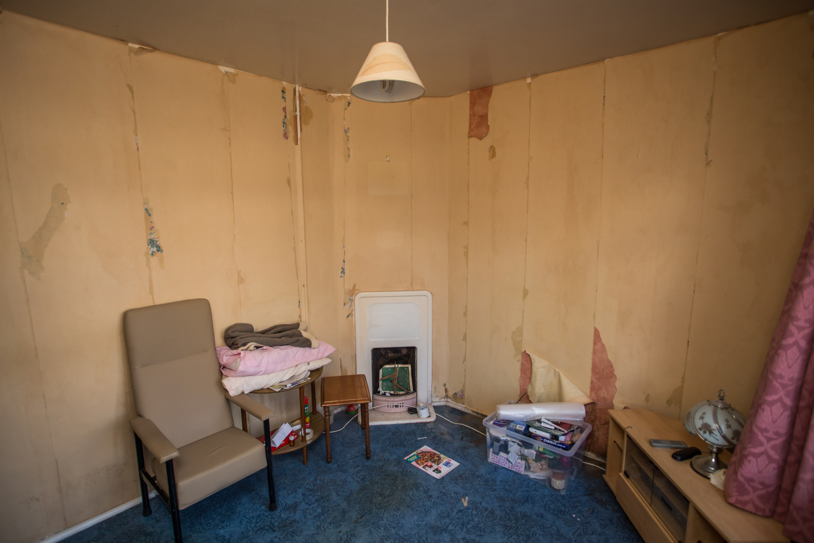
Housing and Homeless Crisis
Empty Homes

Slide 7
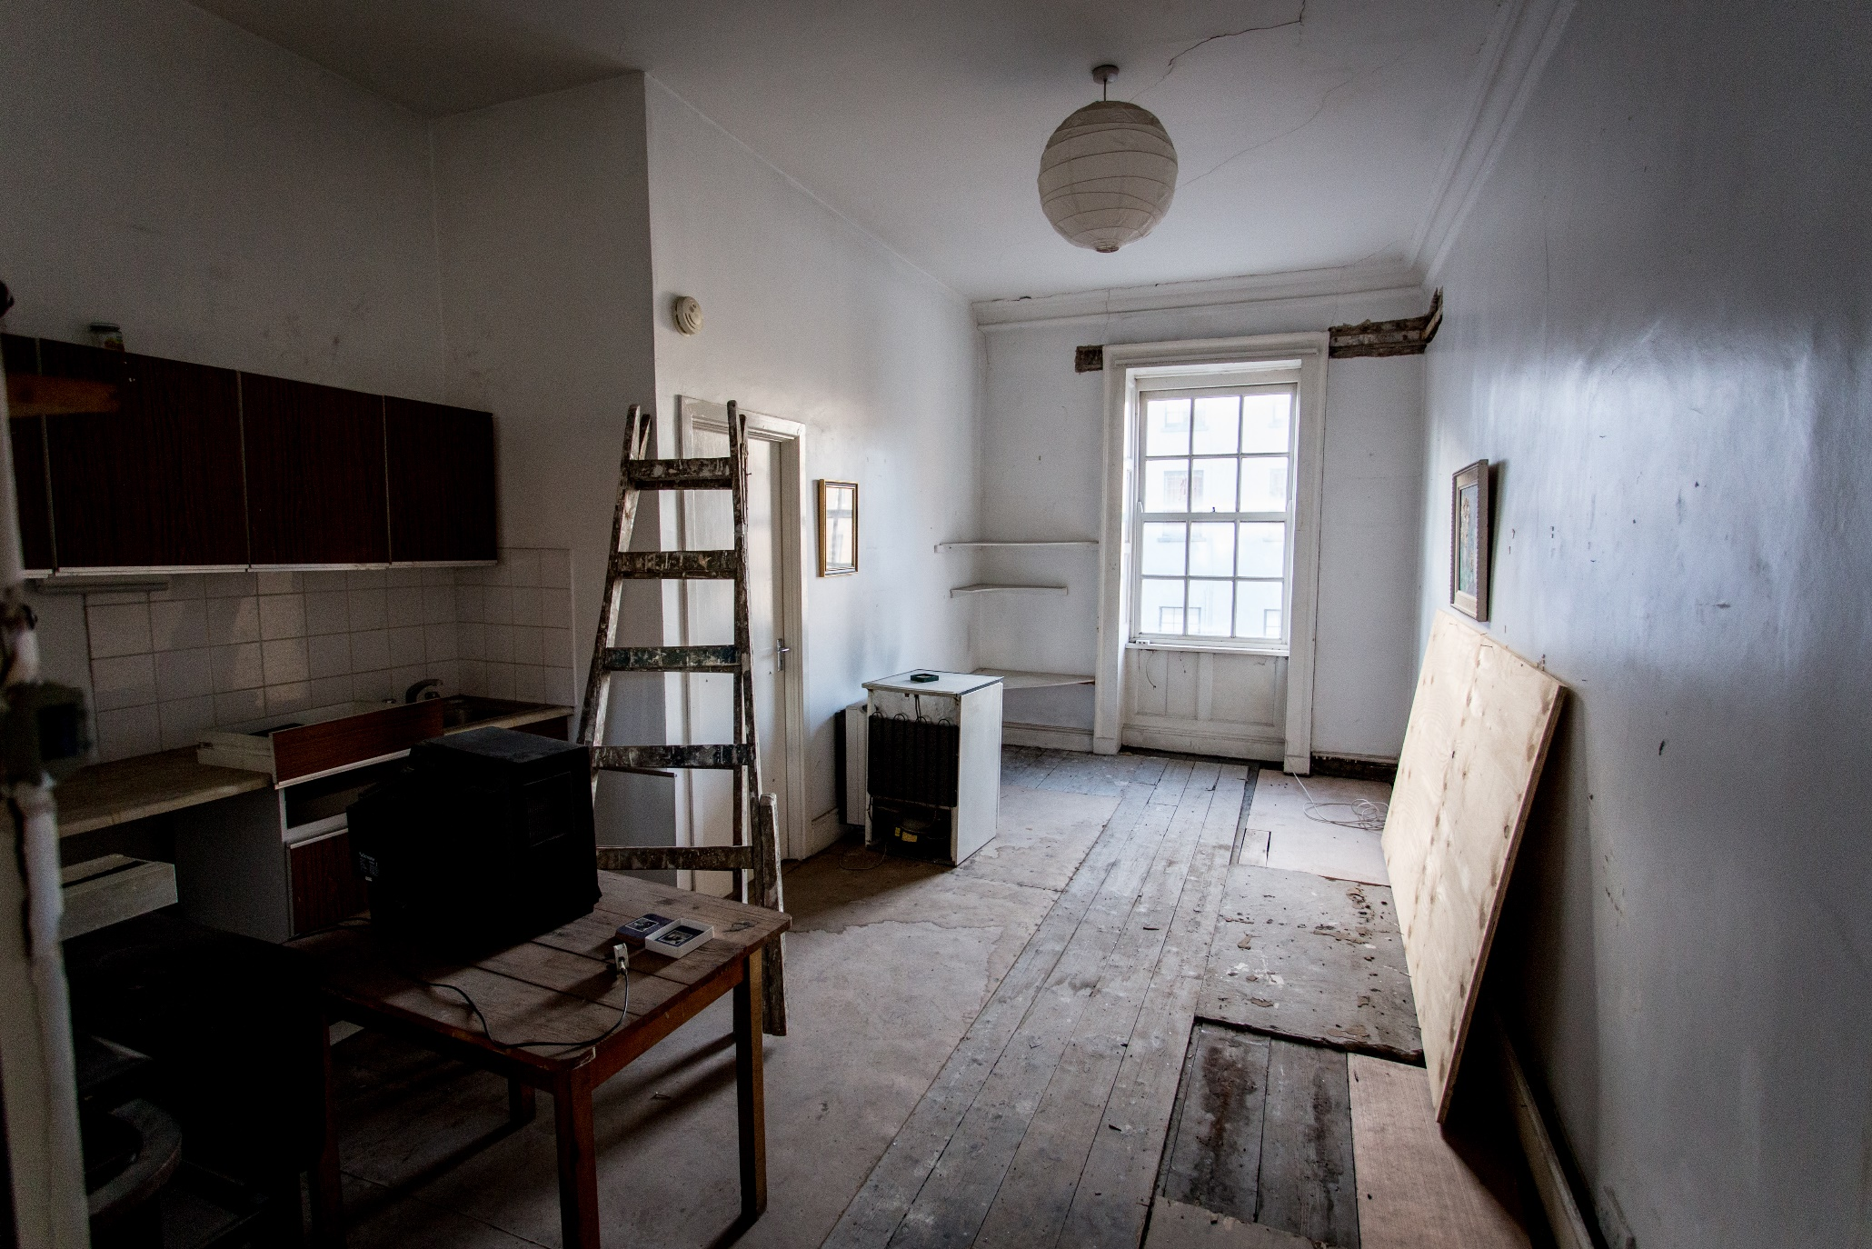
Housing and Homeless Crisis
Empty Homes

Slide 8
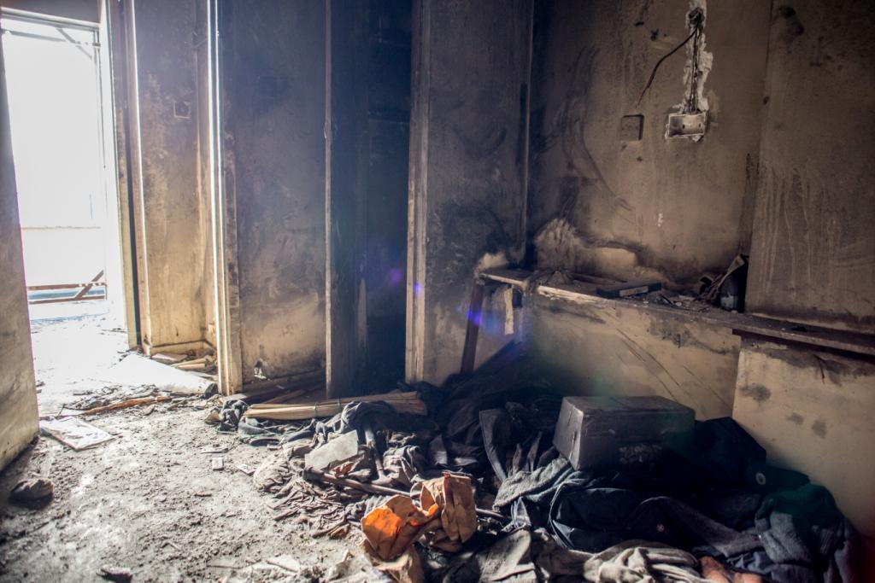
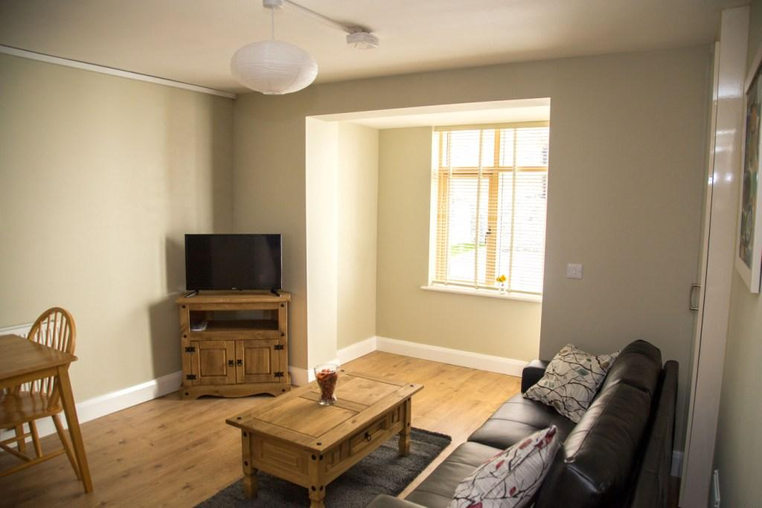
Housing and Homeless Crisis
St Agatha’s Court, Dublin City Centre ( June 2017 - 11 Units)
(Public Housing – 2016/2017)

Slide 9
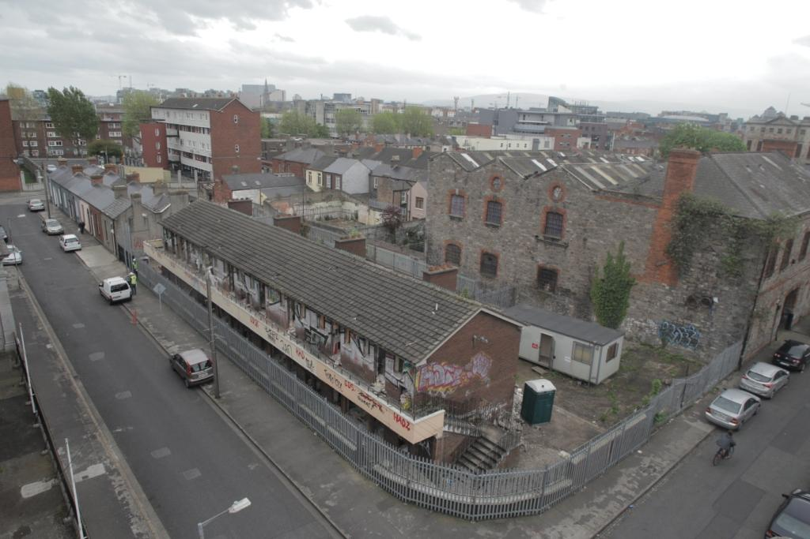
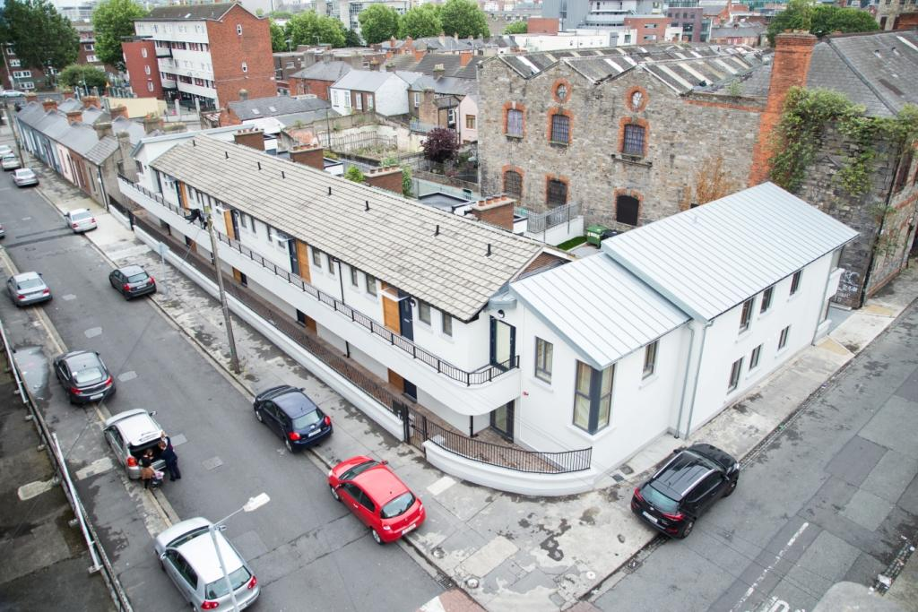
Housing and Homeless Crisis
St Agatha’s Court, Dublin City Centre ( June 2017 - 11 Units)
(Public Housing – 2016/2017)

Slide 10
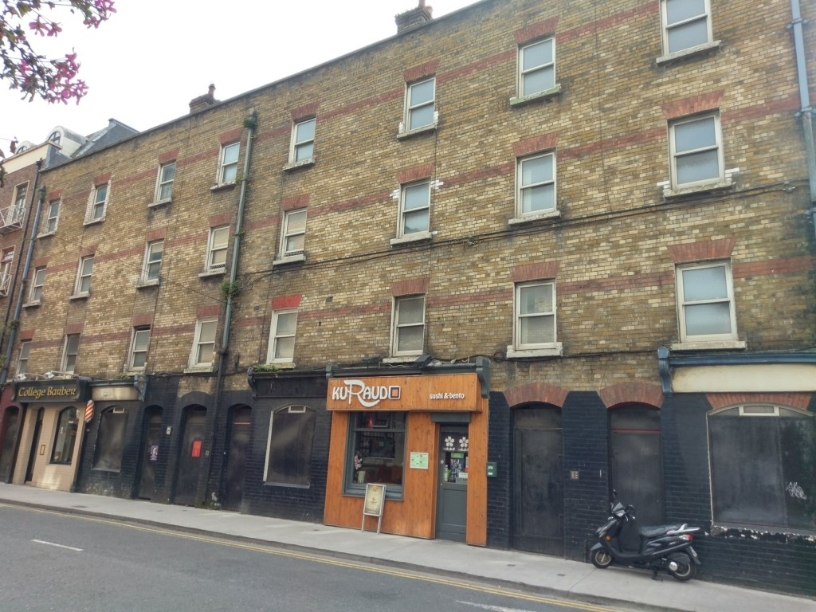
Housing and Homeless Crisis
Townsend Street, Dublin 2 (18 Units)

Slide 11
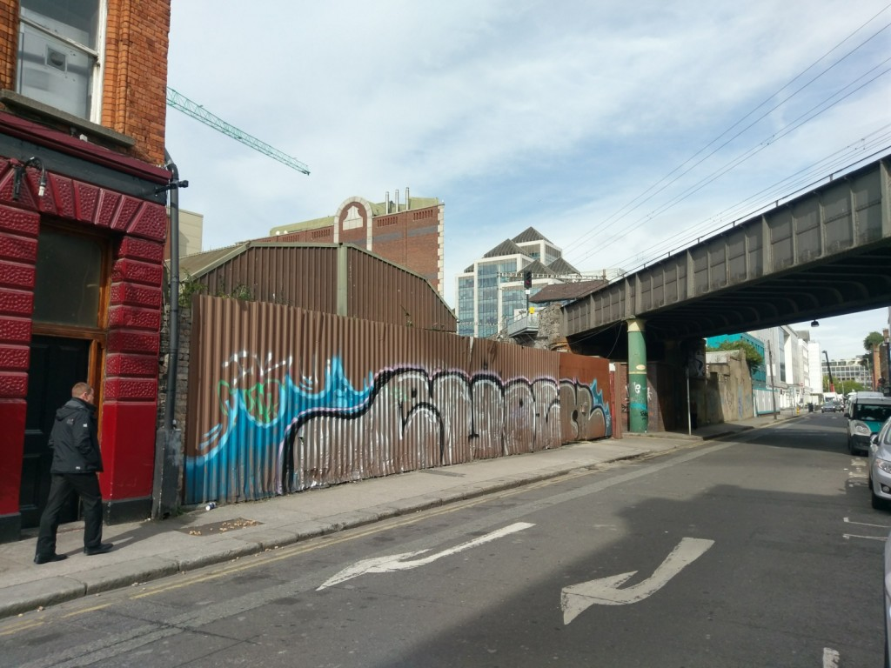
Housing and Homeless Crisis
Small scale derelict sites
Small Scale Derelict Sites
12 Apartments, Shaw Street, Dublin 2

Slide 12
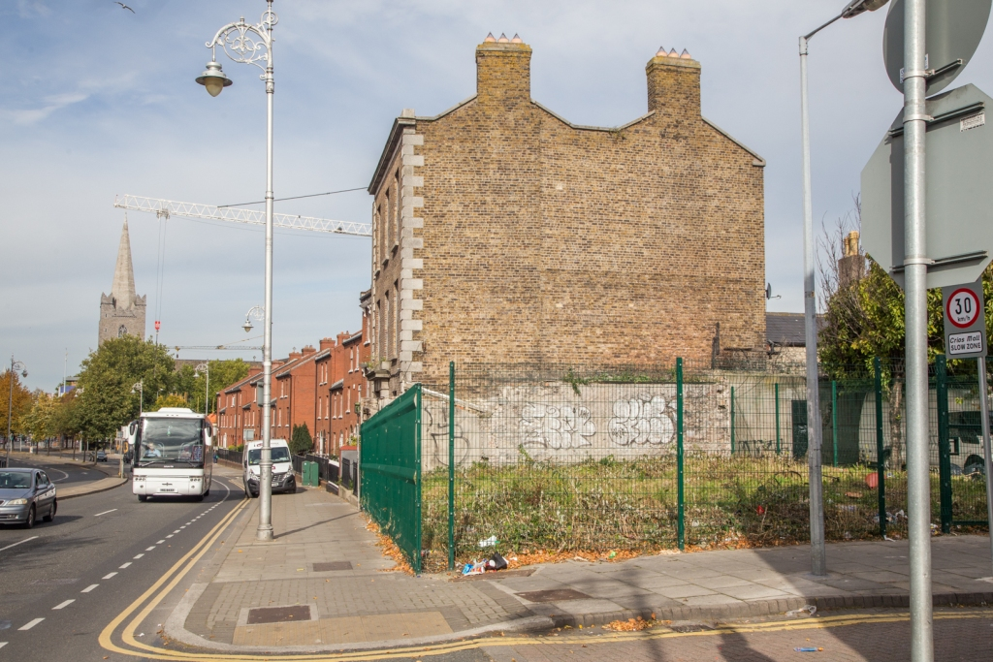
Housing and Homeless Crisis
Small Scale Derelict Sites
8 Apartments, New Street South, Dublin 8

