Slide 1
Presentation ICTU Friday Briefing: Homeless ireland 8th September 2017

Slide 2
Set out the scale of the problem
Share some analysis
Talk about some potential solutions

Slide 3
Homelessness in Ireland: July
8,160 people in emergency homeless accommodation
2,973 (one-in- three) of them is a child
Homeless families up 300% since July 2014.
68% of homeless in Dublin Region
84% homeless families in Dublin region

Slide 4
Homelessness: the tip of the housing crisis iceberg
Rough-sleeping: Approx 250
Emergency Shelters 3,200
Families: 1,429 (1,953 parents, 2,973 children)
Squats, sofa-surfing, doubling up
Private rented tenants – rents, evictions
Social housing waiting list: Approx 95,000
Mortgage arrears over 1yr: 41,000
People trying to get a mortgage
Young people returned to family home

Slide 5
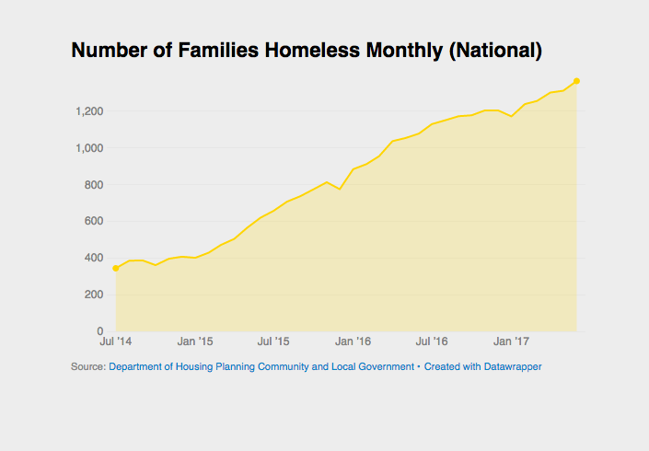
Steadily growing for 3 years
Notes:
Almost straight line – main variation is seasonal (January/December)
No ‘sudden influx since March’
A series of policy instruments came and went
Allocations Directive to homeless
Setting up of HAP and Homeless HAP
Family Hubs
All the evidence points to the fact that what is pushing this is not these factors
There is very little evidence or knowledge. DRHE do some research but do not publish it.
Focus Ireland – work on families in Dublin

Slide 6
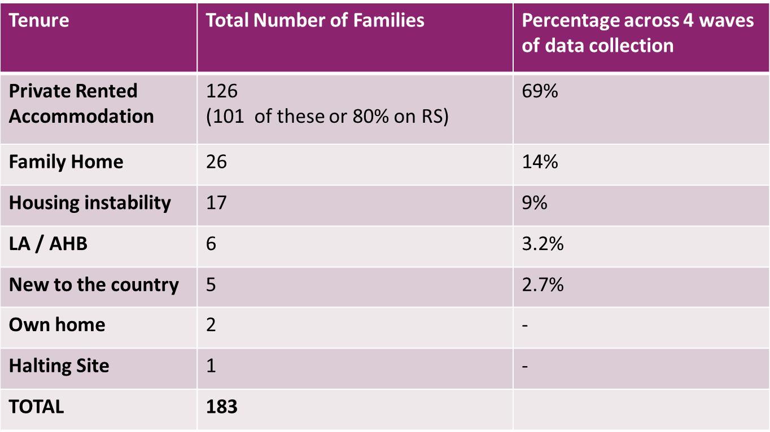
Last Stable Accommodation of families becoming homeless

Slide 7
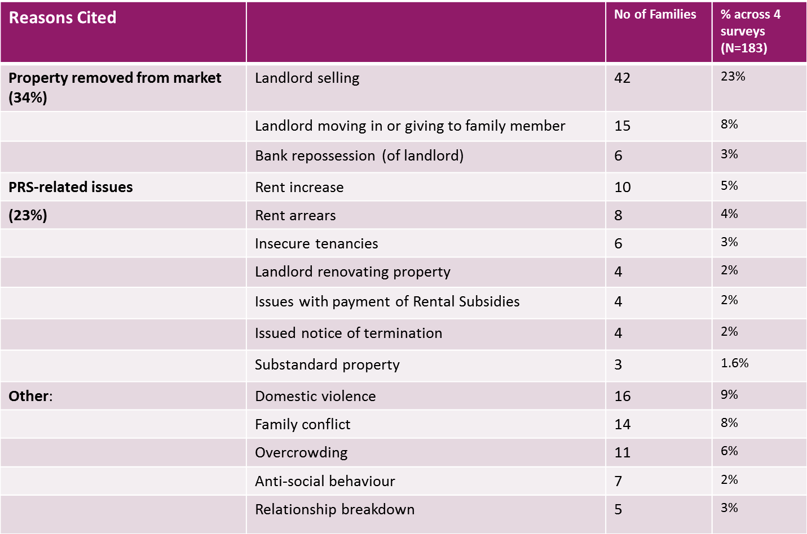
Commonly-Reported Reasons for Leaving Last Stable Accommodation

Slide 8
Four family trajectories into homelessness
Stable Housing History (50%)
Precarious Housing History (38%)
Unstable/chaotic housing history (11%)
Youth pathways into homelessness (16%)

Slide 9
Prevention
‘Focus Ireland amendment on buy-to-lets
Vulture funds
Rent control, HAP/RS levels etc
Advice and information – targeted
Care leavers and other young people
Young families
The problem of temporary measures….

Slide 10
Emergency provision
No one should be left without shelter… but
Increase of 1,200 emergency beds since Dec 14
Housing First
Family Hubs

Slide 11
Housing
Social housing policy created the problem
…and is the solution
Funding and delivery
”

Slide 12
Housing 2
“While we shall be judged for a year or two by the number of houses we build, we shall be judged in ten years' time by the type of houses we
build
Building needs to be on a large scale
Affordable and Cost Rental
Poverty and mental health
”

Slide 13
Thanks
Questions and Discussion

