Slide 1

A NEW COURSE FOR BETTER TIMES
An Investment Plan for Europe:
Rebuilding after the Crisis
Irish Congress of Trade Unions, 11 April 2014
Reiner Hoffmann

Slide 2
1. Understanding the Crisis
Notes:
Thank you very much for your invitation to present our DGB Marshall plan for Europe.
My presentation begin with the 1. Step “Understanding Crisis” und end in 5 Steps with a conclusion.

Slide 3
Different faces of crisis
financial
market
banking sector
insurance
sector
public
finance
debt crisis
inefficiency
administration
shadow
banking
political crisis
political instability
democratic
legitimation
real
economy
competitiveness
social crisis
poverty
unemployment
Investment
Notes:
Before we begin to develop step by step the structure of Marshall Plan we need to describe and understand the crisis.
We can show 4 faces of crisis: Crisis of the financial market with the crisis in the Banking sector, insurance sector and the problem of shadow banking.
And the crisis of public finance: It is the most discussed challenge in the currently crisis management.
The political crisis is the main problem with different faces: political instability in the peripheries and the rise of anti-European movement in all European countries and decreased solidarity in the northern countries.
Bur the last faces and I think most important point is economic crisis which is present in the daily life of European citizens. High unemployment, wage and pension cut, collapse of local markets, decreased incomes for domestic companies and other several examples stop the positive vision of European project for million of European citizens.
Furthermore we don’t have as continent with high innovation problems with the competitiveness but of course inside of EU we must reduce the gap between regions und European countries. And we have much different problems between south and north, between small and bid economies and much more problems.
But the question is how we can come out from the crisis und use in the same time all our knowledge and experience to put the economic fundament and close the gap in development of member states.

Slide 4
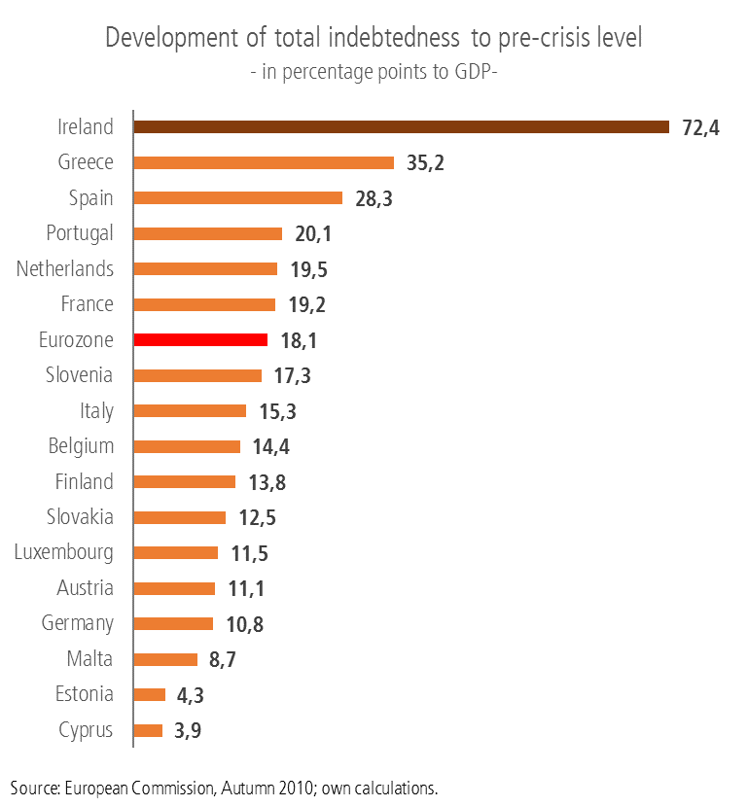
Development of total indebtedness to pre-crisis level

Slide 5
Austerity policy has left euro area unemployment rate
at a record 12.1 %, and markedly higher in some countries

Slide 6
Challenges for policy
Stable growth & high income = fundament for social Europe
Sustainable and Stable Financial System
High liquidity and solvency, reducing risk
Businesses Sector
Investment, debt reduction
Private Households
Consumption, debt reduction
State
Public investment, debt reduction
Social Europe
Private Sector
High productivity, secure and decent employment, stable income (capital/labour)
Public Sector
Efficiency administration, high tax income
Sustainable and Stable Growth
high competitiveness and high income

Slide 7
2. ETUC Investment Plan:
Making Economy of Tomorrow

Slide 8
Challenges for policy
Making Sustainable Economy of Tomorrow
Economy of tomorrow
Sustainable economy & income
Sustainable ecology
Sustainable public finance
Sustainable
Social system

Slide 9
Making economy fit for the competetivness of tomorrow
EP-Council-EC
definie short-
and long-term goals
European Investment Fund
promotes investments in
European Energy Policy
Public & Private Services
Transport Infrastructure
Education & Training
Broadband Networks
Demographic Transition
Sustainable Industrial Modernisation
Social Housing
2% of EU-GDP p.a.
Notes:
We defined 8 investment field, which are the MUST of the economy and competitiveness of tomorrow.
O transformation our
The first 4 major fields are the key for the sustainable modernisation of European industry. We will spend annually 200 billion Euro for European energy Turnaround, modernisation our transport infrastructure, broadband networks and the Europeans industrial basis.
With last 4 investment fields we put the fundament for the better European society for young and old, for European citizens. We will spend annually 60 billion Euro for public and private sector, for high quality education and training, for the modernisation of public infrastructure and housing for old and disabled people and for sustainable water use.
We think for this European project we need an European institution, an European direction : for us an European Future or Investment funds, which must controlled by EP, Council and EC.
It is together annually 260 billion Euro investment in the future of our economy. In our proposal we design our Marshall Plan for 10 years.
For the next two years we will spend 20 billion Euro to stabalise the business cycle in the crisis countries.

Slide 10
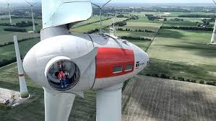
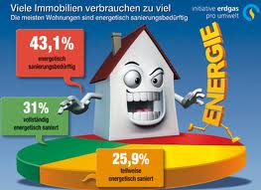
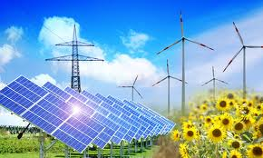
Key aspects of Investment Plan
European Energy policy
Investments in (i.e.):
Renewable energy
New grids
Decentralised combined heat and power plants
Renovation of buildings in terms of energy efficiency
Services and Education in those fields
European Energy Polica
Reiner Hoffmann, VB05, Mitglied des Geschäftsführenden Bundesvorstandes, 11.04.2014

Slide 11

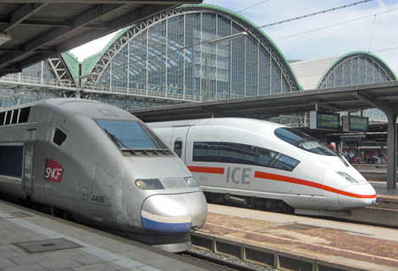
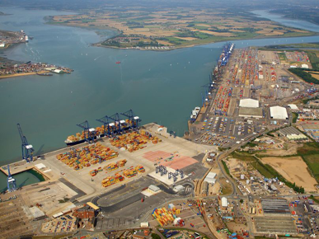
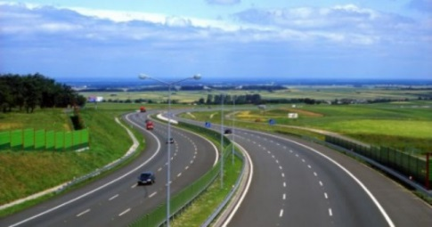
Key aspects of Investment Plan
Transport Infrastructure
Investments in (i.e.):
Socially, environmentally sustainable transport systems
Smart mobility concept
Insufficient infrastructure
Germany needs for renewal in municipal transport infrastructures (local public transport and for railways, roads, bridges and tunnels)
Transport Infrastructure
Reiner Hoffmann, VB05, Mitglied des Geschäftsführenden Bundesvorstandes, 11.04.2014

Slide 12

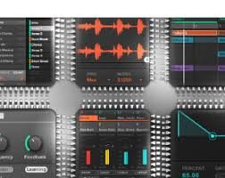
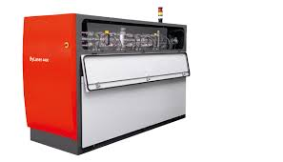
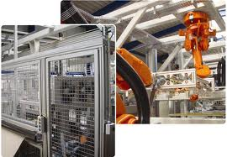

Key aspects of Investment Plan
Strengthening Europe´s industrial future
Investments in (e.g.):
Energy efficiency and efficient use of resources
Low-interest loans for long-term investments
Small industries in structurally weak regions: 5-10 years without interest or repayment
Microcredit programme in Crisis States
Sustainable Industrial Modernisation
30 billion EUR
Reiner Hoffmann, VB05, Mitglied des Geschäftsführenden Bundesvorstandes, 11.04.2014

Slide 13


Key aspects of Investment Plan
Public & Private Services
Investment in (e.g.):
Strengthen welfare state
Modernise and built hospitals, Buildings and Equipment for youth work and social work
Research & Innovations in services (as a driver for technological innovations)
Making European cities green and social
Public & Private Services

Slide 14
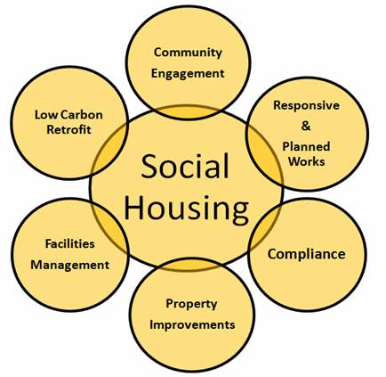
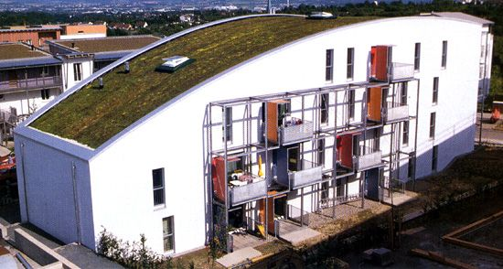
Key aspects of Investment Plan
Social Housing
Investment in (e.g.):
Stop eviction and homelessness
Modern & Green Social Housing
Social Housing

Slide 15
3. Macroeconomic effects of
ETUC Investment Plan

Slide 16
Macroeconomic effects
(additional, longer-term avaerage)
Multiplier | 1.2 Minimum | 1.5 maximum
GDP (EUR, billion) | 312 | 390
Full-time Jobs (million) | 7.2 to 8.8 | 9 to 11
Tax revenue (EUR, billion) | 83 | 104
Social security contributions (EUR, billion) | 45 | 56
Savings in unemployment benefit expenditure (EUR, billion) | 16 | 20
Savings in fossil fuel imports (EUR, billion) | 300 | 300

Slide 17
4. Funding the Investment Plan

Slide 18
Funding the Investment Plan
Moblising European Capital for European Investment
27,000 billion Euro
net assets under management in Western Europe
financial markets
10 years Bonds
Capital
FTT
European Investment Fund
promotes investments and demand
Fund needs Initial / Own Capital:
Proposal for Germany:
3% one-off wealth levy on private
assets above 500.000€ (single)/
1 Million (couple)
Demand
State
Private
Households
Companies
Supply
real economy

Slide 19
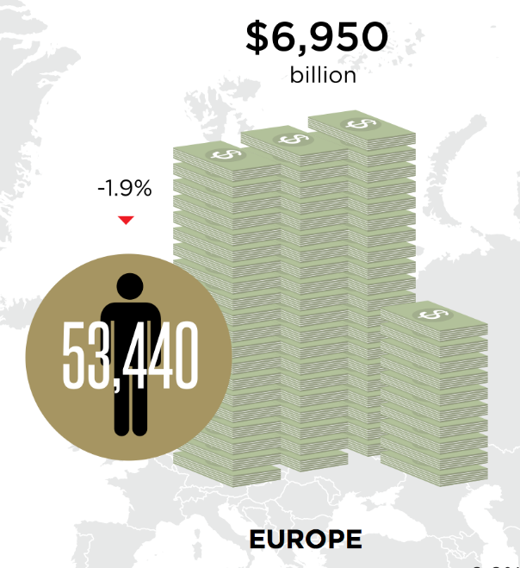
3% one-off Levy on Wealth
Who pays?
3% one-off levy on Ultra-Wealth
(individuals with minimum US-$ 30 million net-wealth)
3% one-off levy on Wealth (DGB Proposal)
(individuals with minimum US-$ one million net-wealth)
€-Zone = 3% x € 3,800 billion
= € 114 billion
EU28 = 3% x € 4,130 billion
= € 124 billion
Europa = 3% x € 8,400
= € 252 billion

Slide 20
5. Conclusion

Slide 21
„ETUC Investment Plan for Europe“ provides investment in economy of tomorrow
Investment in
Economy of
tomorrow
Net Wealth
F
I
N
A
N
C
I
L
M
A
R
K
E
T
Investment Plan
Asset Investment
Reiner Hoffmann, VB05, Mitglied des Geschäftsführenden Bundesvorstandes, 11.04.2014

Slide 22
Thank you for your attention

