Slide 2
UK State Pension Changes from 6th April 2016
Old Age Pension scrapped;
Key Points of New Flat Rate Scheme.
Single Pension Scheme;
Full Rate Entitlement (£155.65pw v £119.95 + SERPS or Pension Credit) based on Contribution Record;
Qualifying Period 35 years v 30 years, National Insurance contributions;

Slide 3
UK State Pension Changes from 6th April 2016
Key Points of New Flat Rate Scheme (continued).
No entitlement based on dependants National Insurance Record;
It will be 2050 before every pensioner fully qualifies for the new full rate;
No switch over from current OAP to new flat rate scheme;
By 2050 UK Government GDP expenditure on State Pensions to be cut from 8.6% to 8.1%;

Slide 4
State Pension Age Changes
Recent years women on a tapered change to align age of retirement with men i.e from 60 to 65 (to be completed by Nov 2018);
New Scheme – For men whose date of birth is later than 5th April 1951 and for women whose date of birth is later than 5th April 1953 the current state pension will no longer be available and the new State Pension called the flat-rate State Pension will become payable;

Slide 5
State Pension Age Changes
From 2020 State pension age becomes 66;
From 2026 to 2028 State pension age becomes 67;
Thereafter each parliament will review the age, with aim of increasing it to 70 by 2040;
Public Service Pensions normal retirement date aligned to new state pension age (limited exceptions and some protections).

Slide 6
The link with State Pension Age
One of the most contentious impacts of the reforms;
Exceptions to this direct link are in place for Police And Firefighters;
This is an area that will be considered under the biannual reviews required under section 10 of the Act;
The closest to retirement have transitional protection;

Slide 7
Automatic Enrolment
Employer helps individuals build pension savings
The new social norm – employer pays tax, NI and pension
Success so far is encouraging; low opt out
Significant challenge still ahead – 1.8m employers yet to start
Auto-escalation for the future
How will they find a good scheme?
Net pay vs. Relief at source

Slide 8
Pension flexibilities – where we are
More freedom and choice over how to access pension savings after age 55
No longer have to buy an annuity
Instead can choose to take money in a number of ways
Pension Wise offers unbiased guidance on options
Want people to wait longer, not spend pension too soon

Slide 9
Issues Going Forward
Westminster Four Pension Bills/Acts;
Pensions Act: Single Tier State Pension;
NRA/SPA link and increase;
Finance Act: Access DC Pensions
Pensions Schemes Bill: Redefines Pension Schemes
Collective DC Funds
Taxation of Pensions Bill: Mainly taxation of DC Scheme early access funds.
TPA Codes of Practice.

Slide 11
Why an Occupational Pension
UK Government is responsible for pensioner poverty. In Europe only Cyprus, Latvia and Estonia are worse;
Past 30 years State Pension (Old Age Pension) devalued from being worth 25% average male earnings to 15%;
Basic State pension £115.95 Single £185.45 Couple;
Poverty Level £198.40 Single £244.96 Couple; circa 15% pensioners in real poverty
3.5 million UK pensioners live in fuel poverty;
A fairer pension for all is attainable in the sixth largest economy in the world if the Government would only choose it to be.

Slide 12
Why the assault on Public Service Pensions
Funding Deficit;
Private Sector Retreat;
Public Expenditure Cuts;
Managing Financial Deficit;

Slide 13
Truth not Myth (UK)
Re: Public Service Pension Pensions

Slide 14
The Coalition’s reforms to the Public Sector Schemes
Switch from Final Salary to Career Average Revalued Earnings (CARE);
Linking of Normal Pension Age to State Pension Age (except uniformed services);
Higher rates of contributions from scheme members (+3.2% on average except LGPS/NILGOSC) and tiered contributions;
Reforms apply to all members for future accrual but protections for members within 10 years from their Normal Pension Age on 1 April 2012;

Slide 15
The largest four public sector pension schemes post reforms
 | NHS/NI | Teachers/NI | Civil Service | Local Gvmt/NILGOSC
Normal Pension Age | SPA | SPA | SPA | SPA
Basic Design | CARE | CARE | CARE | CARE
Revaluation | CPI +1.5% | CPI +1.6% | CPI | CPI
Accrual Rate | 1/54th | 1/57th | 1/43rd | 1/49th
Member contributions (future service) | 5% to 14.5% | 6.4% to 8.8% | 4.6% to 9% | 5.5% to 12.5%
Indexation of pensions paid | CPI | CPI | CPI | CPI
Implementation | 1st April 2015 | 1st April 2015 | 1st April 2015 | 1st April 2014/15 (NI)

Slide 16
Truth not Myth Re: Public Service Pensions
Paying More for Less;
Public Service not a Job for Life;
Impact Grey Economy;
Total Reward – Private Sector v Public Sector;
NHS + LGPS Cash positive;
Subsidising/Off-Setting Pension Credit entitlement;
Pensioner Poverty and Costs to Welfare State.

Slide 17
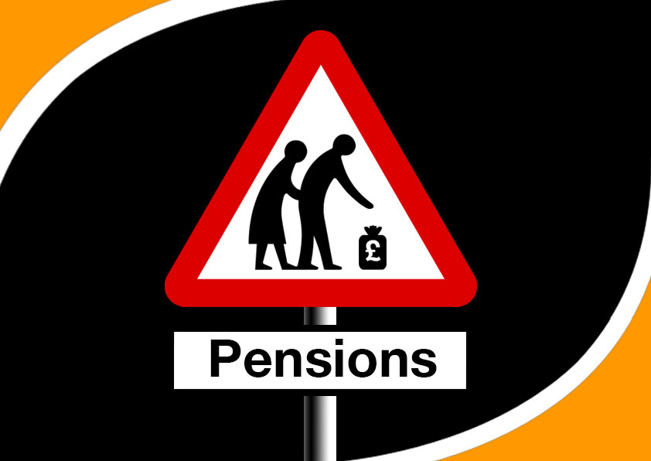
Ref PP_0586

