Slide 1
What ever happened to retired workers’ legitimate expectation?

Slide 2
Before the crises retired workers thought they were ‘protected’
Workers who were in no occupational scheme could rely of their social insurance contribution for their pension.
Workers in funded schemes could rely on the Pension Board to keep their pension funds safe and on retirement could buy an annuity which guaranteed a pension for life (often including increases to pension in payment).
Public Servants had guaranteed pensions with indexation because a sovereign Government never welches on its debt.
All of this was under written by the doctrine of legitimate expectation

Slide 3
What happened to Social Insurance Pensions?
`The bands were changed in a way that had the effect of taking €1,500 of many workers three quarters of whom are women
The pension age was raised by three years without any consideration of the labour market issue involved.
This change is a grossly inequitable attack on lower paid workers.
A manual worker on class A PRSI born in 1955 will (if they are lucky) work for 51 years before they receive a cent of their contributory pension. (at age 67)
A senior civil servant born in 1955 paying the lower PRSI contribution will after 40 years get a generous pension. (at age 60)
The problem gets worse when the pension age goes up to 68.

Slide 4
Some issue to keep in mind
The extent of the Defined Benefit collapse
How workers in funded pension plans have lost the pensions they earned and paid for.
The failure of our pension regulation system.
The negation of worker influence over their pension funds by the pretence they are merely ‘consumers’.
The proposed universal pension system

Slide 5
What happened workers in funded pension schemes
Defined Schemes Active members
31/12/06 1,232 269,529
31/3/15 703 137,000

Slide 6
Or to be more specific:
703 – no. of DB plans still in existence Ireland, a reduction of 50%
90% - proportion closed to new members
83% - proportion of those choosing DC for new members
40% - 50% - no. of DB plans closed to future accrual
75% - proportion of those choosing DC for future accrual
Those pensions with no indexation will lose 50% of value over twenty years

Slide 7
Some have learnt nothing from this catastrophe
Workers paid €100 million over 20 years to the Pensions Board (now the pension Authority) to protect their pensions.
The PA regulated trustee behaviour and for the most part ignored the overexposure of Irish pension funds to high risk investments.
The PB also ignored the performance of DC. The PA takes €10 from every DC member but does nothing to regulated the performance of DC
Before the crash 66% of Irish pension assets were in high risk equities as opposed to 25% in UK.
The government and the PB insisted on overvaluing liabilities making good DB schemes appear un-sustainable.
With levies and ill-advised misdirected regulation, DB was regulated almost to extinction with workers carrying the losses.

Slide 8
What happen to retired public servants
Pension reduction of 4% with the introduction of USC, Property Tax and Water Charges.
Retired members semi-state in funded schemes saw their pension funds plundered through levies.
Section 50 applications saw the end of increases to pension in payment in many funded schemes.
Section 50 applications which abolished increases to pension in payment will see people descend into poverty from the day they retire.

Slide 9
Universal provision and the OECD Report 2013
‘Compulsion is the less costly and most effective approach to increase coverage of private pensions.’
‘Automatic enrolment is a second-best option. Its success depends on how it is designed and on its interaction with incentives in the system.’
Outgoing Minister is in favour of auto-enrolment.
Congress is examining the options and is likely to campaign for a new universal funded pension scheme

Slide 10
What a new universal scheme should look like
It might be called a ‘Solidarity Fund’ ;
It should be controlled by and arm of the National Treasury Management Agency (NTMA);
NTMA should invite specialist companies to bid for the investment work;
Release of funds for investment should operate on Keynesian lines in relation to the business cycle;
There should be board of trustees and an agreed set of investment criteria;
The collection of contributions and other administration should be the responsibility of the State;

Slide 11
Universal scheme continued
Workers and employer who are already covered by second pillar schemes will be exempt from contributions;
Contributions would be incremental (In Australia the employer contribution rate was 3% in 1992. By 2020 in will have risen to 12%);
Some portion of the Universal Social Charge should be used an initial employee contribution;
Workers who do not wish to be involved should have a right to opt out.
The fund would consist of individual accounts that follow the worker throughout career;
The fund must be protected from government sequestration in the form of levies etc;

Slide 12
Beware of the conspiracy against member trustees
The Pension Authority and vested interests in the pensions industry are stressing the importance professional qualifications for trustees.
This is a smoke screen designed to divert attention from the abject failure of the Pensions Authority and the Industry to protect or deliver sustainable funded pensions.
This is to pretend that the only thing that went wrong with funded pensions is that trustees were under qualified.
If they get away with this, the only role that workers will have in relation to their pensions is to pay the contributions and take all the risk and suffer all the losses.

Slide 13
Congress will continue to campaign
Push the rise from 66 to 67 our for five more years and only move to 68 with rest of Europe.
The restoration of public servants entitlements.
Demand protection for workers to allow them to stay beyond 65 ?????
Demand a regulation system which has as a first priority the interests of scheme members in place on the current failed system
A universal soft mandatory scheme involving employer, employee and State contributions

Slide 14
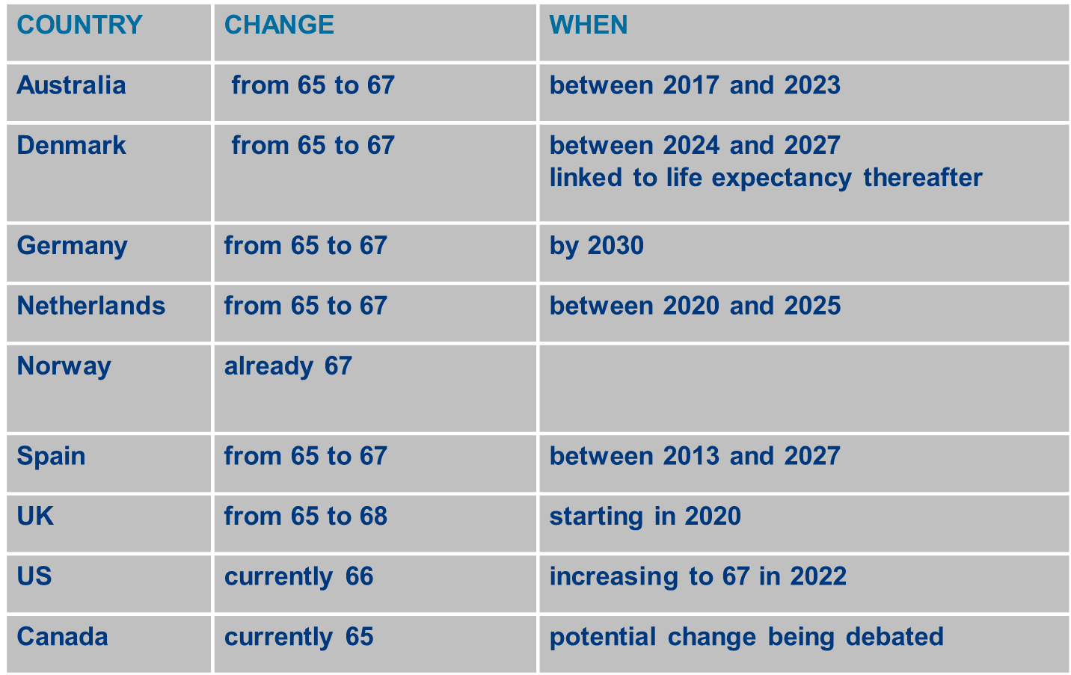

Slide 15
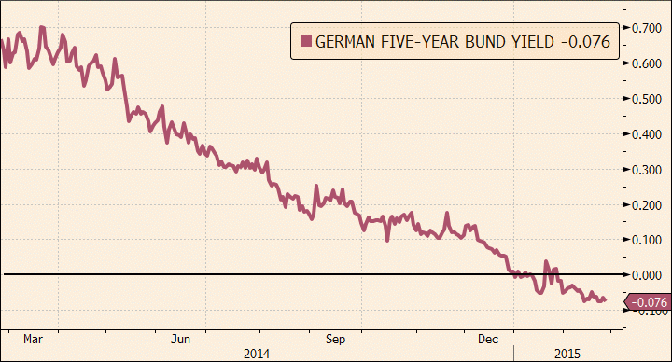
Pension scheme assets are growing but: liabilities continue to soar exponentially

Slide 16
Here’s what’s happened to annuity costs

Slide 17
What this means for DB schemes
With zero bond yields it costs c. €225,000 to buy a pension of €10,000 p.a. for a pensioner aged 70 - almost doubling in cost over 10 years
Assuming 3% yield it costs c. € 175,000 (2012 levels)
Assuming 4% yield it costs c. € 160,000 (2010 levels)
The Pension Regulator insists that schemes are funded by projecting pension liabilities @ zero yield on AAA bonds.

Slide 18
A fairer alternative
The law could be changed so that in the event of wind-up the above trustees could offer a “reasonable” capital value of, say, €150,000 in the form of an ARF rather than pay €225,000 to an insurance company for each pensioner to give them €10,000 p.a.. This would make it easier to meet the funding standard and would likely be very popular with pensioners
Crucially it would leave more money with employees if a scheme was forced to wind-up in a distressed state

Slide 19
For example
Assume 40 pensioners and 40 employees
It is a cruel irony that the current rules not only lead to avoidable wind-ups but also make a bad situation worse by the manner with which they dictate the split of funds.
 | Current Rules | ARF alternative
Fund | €10,000,000 | €10,000,000
Amount needed for pensioners | €9,000,000 | €6,000,000
Amount left for employees | €1,000,000 | €4,000,000
Average pay-out per employee | €25,000 | €100,000

